Slide 1
Information on the Heart
This power point serves to be additional information to prepare you for questions about the heart

Slide 2
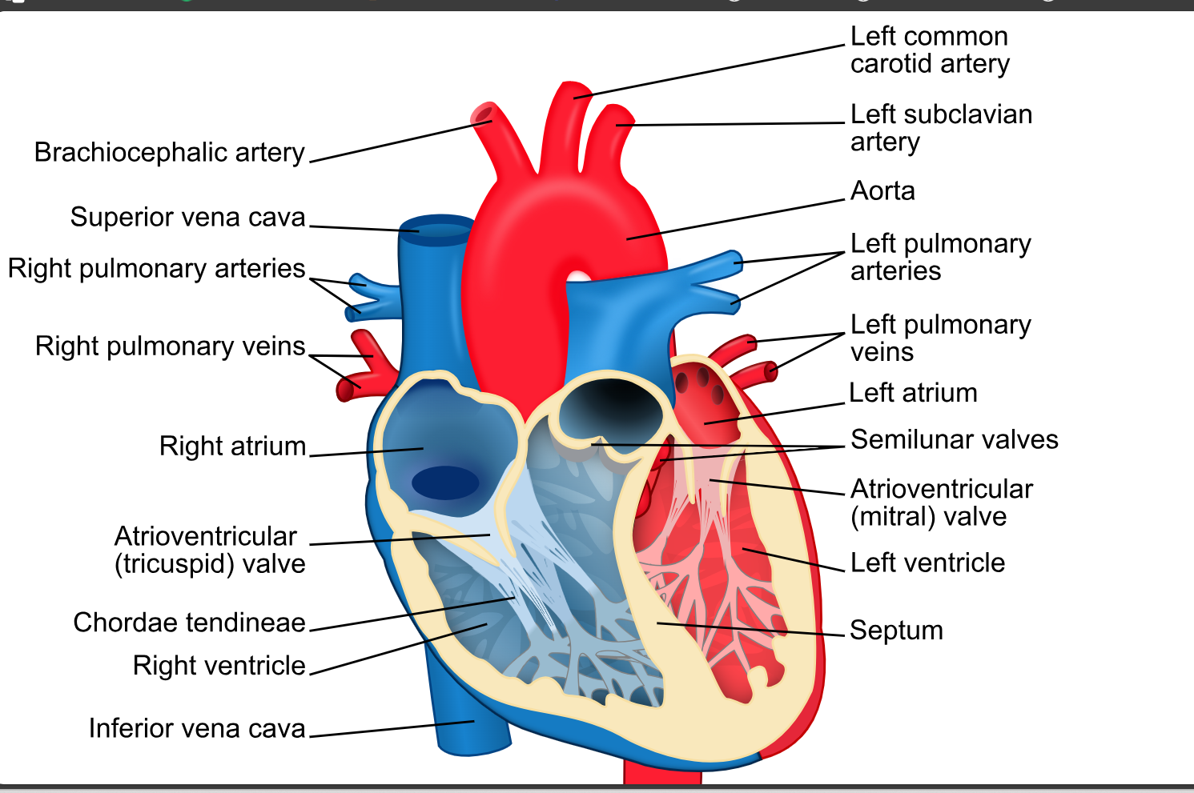
Labeling all parts of the heart
Here is a link to a diagram that labels all parts of the aorta
anatomic-diagram-aorta_278713-1694.jpg (1380×1535)

Slide 3
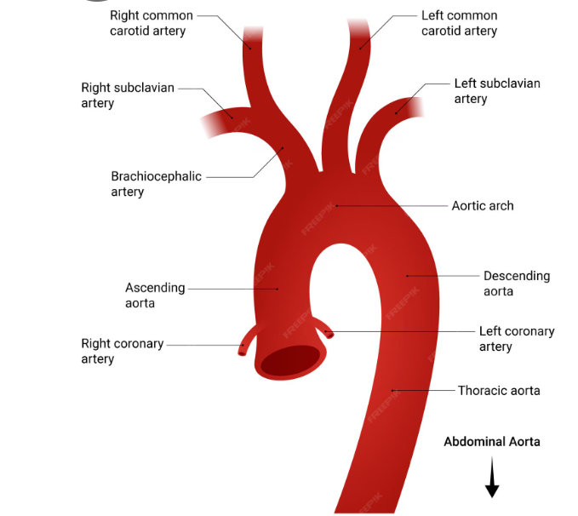
Labeling the Parts of the aorta

Slide 4
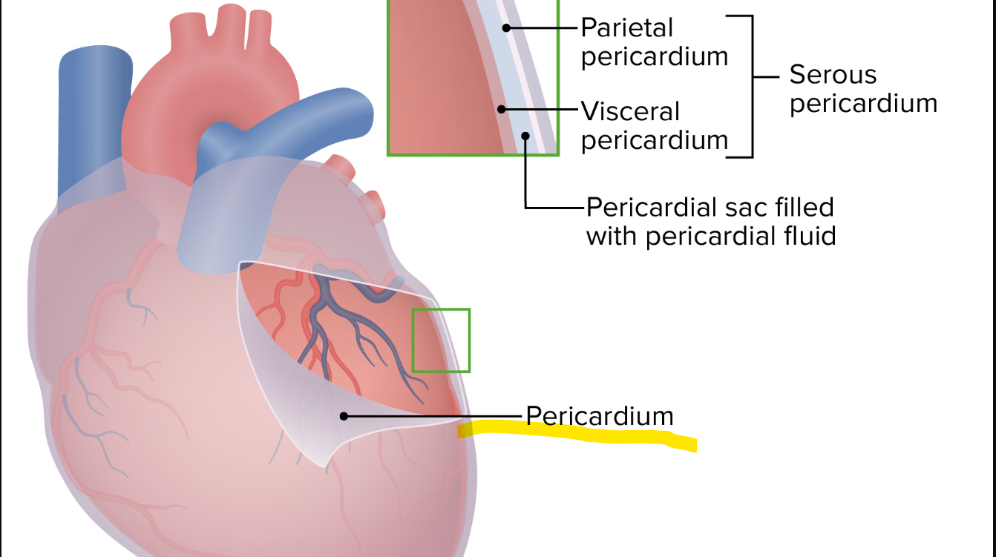
Pericardium
pericardium is a double layered sac that contains the heart.

Slide 5
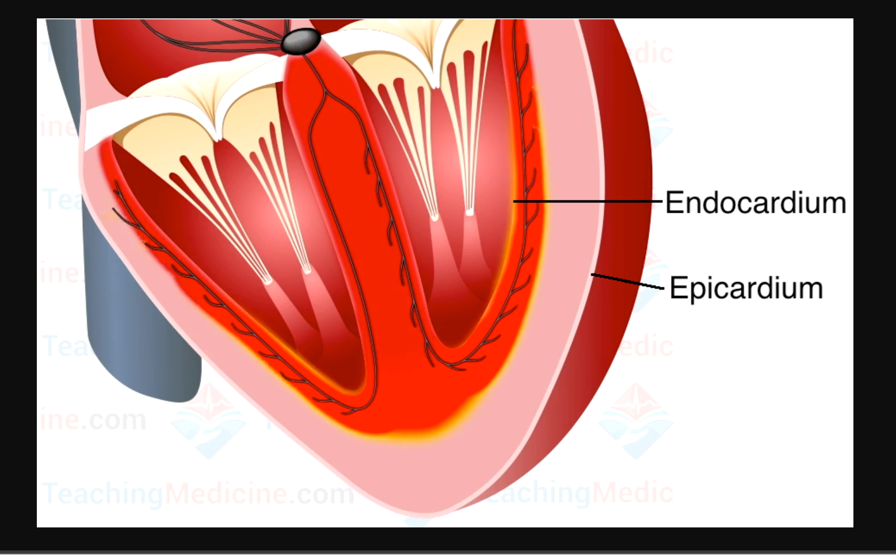
Epicardium
innermost layer of the pericardium. It covers the outer surface of the myocardium. The epicardium contains the blood vessels that supply blood to the myocardium

Slide 6
Endocardium
innermost layer of the heart. it forms a continuous lining that covers the inner surface of the heart.

Slide 7
Right Atria
receive deoxygenated blood returning to the heart.
right atria is larger than the left atria and receives a larger volume of blood than the left atrium.
right atria maintains low pressure of 0-3 mmHg

Slide 8
Left Atria
receives oxygenated blood that returns to the heart.
does not expand to the extent of the right atria but maintains higher pressure 6-10 mmHg.

Slide 9
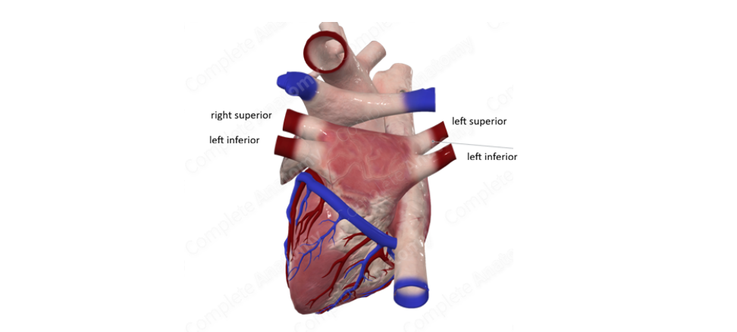
Know the 4 pulmonary veins
right inferior
right superior
left inferior
left superior

Slide 10
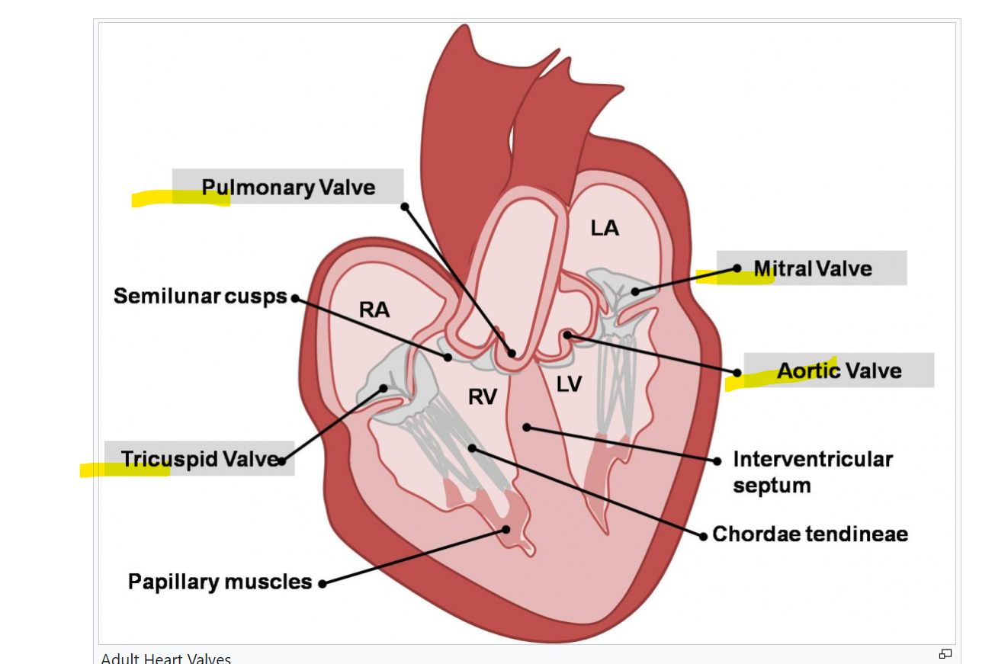
Cardiac Valves
Four valves
  atrioventricular valves separate the atria from the ventricles
    mitral valve
    tricuspid valve
  semilunar valves separate the ventricles from the large blood vessels leading blood away from the heart
    pulmonary valve
    aortic valve

Slide 11
Cardiac Valves

Slide 12
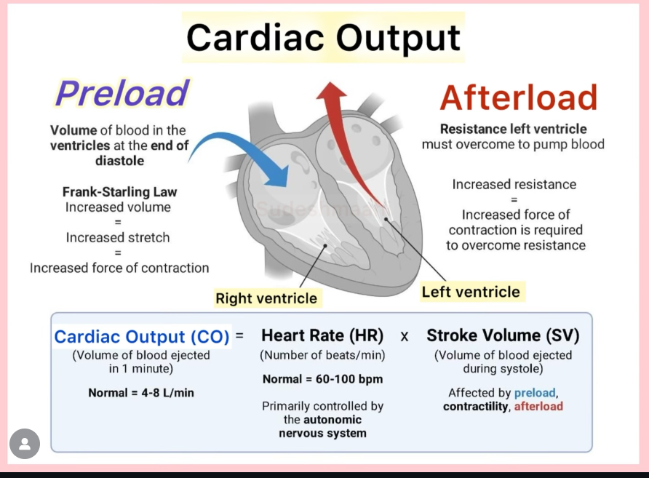
Cardiac Output

Slide 13
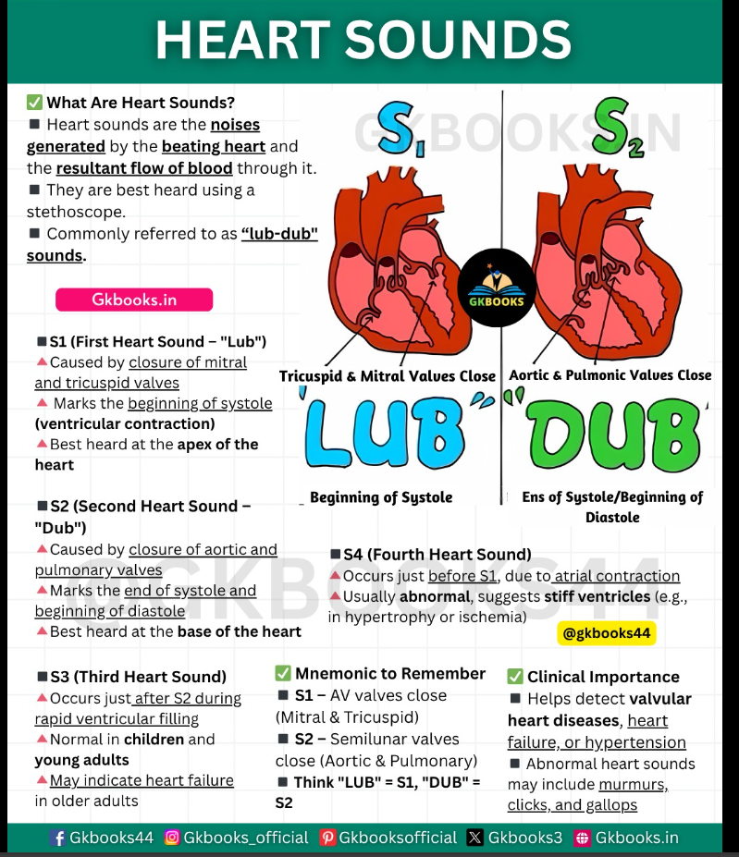

Slide 14
Heart Sounds
S1- sound 1 is the sound of the opening of the atrioventricular valves (mitral and tricuspid valves open), marking the beginning of systole
S2- sound 2 is the sound of the semilunar valves opening (pulmonary valve and aortic valve) marking the end of systole and the beginning of diastole.
S3- sound 3 is the sound of the ventricle filling with blood (normal in children and young adults, may be a sign of heart disease in older adults)
S4- sound 4 is the sound of the atrial contraction that occurs right before sound one starts again
side note- S3 and S4 cannot be heard with a standard stethoscope

Slide 15
Veins and arteries
major systemic veins
  SVC & IVC
major system arteries
  aorta
major coronary arteries
  Right coronary artery
  left main coronary artery
  left circumflex artery
  left anterior descending artery
major coronary veins
  left cardiac venous system
  right cardiac venous system

Slide 16
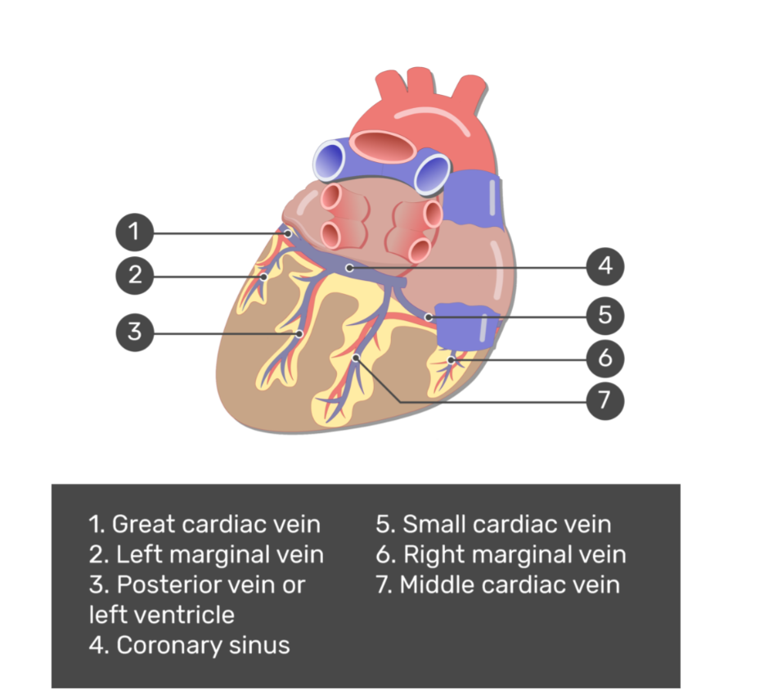
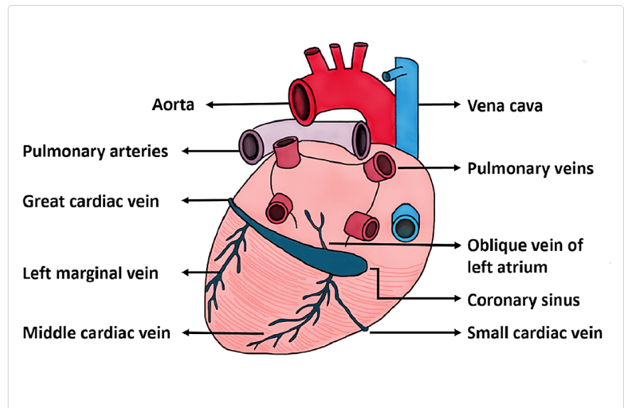
Major coronary veins
Here is a website where you can study this diagram and test yourself with labeling this diagram https://www.getbodysmart.com/heart-anatomy/coronary-veins/

Slide 17
Mometrix videos about the heart
mometrix.com/academy
Best mnemonics for Heart Anatomy and Physiology code:849489
Heart anatomy and physiology code: 569724
Heart blood flow code: 783139
Electrical conduction system of the heart code: 624557
Myocardial Infarction code: 148923
Diastolic vs systolic code: 898934
https://www.youtube.com/watch?v=0l7nxUeTnlo

