Slide 2
Health By Design USA Inc. is a nonprofit organization that is dedicated to providing health education which addresses obesity, heart disease, diabetes and Hypertension among children and adults in the community.

Slide 3
Overview
Mission and Vision
History
Executive Team
Scope of Service
Need
Customer
Services
Social Impact
Community Events
Resources

Slide 5
History
Health by Design USA, Inc. (Health by Design) was founded in 2011 by Ms. Dorothy Richards, RD recognized by IRS as a 501c3 organization.
Born in Jamaica
Graduated from Andrews University
Worked, as a nutritionist
New York Hospital and Brooklyn Jewish Hospital and Medical Center.
Seminole County Health Department

Slide 6
History
Upon retiring from the Seminole County Health Department in 1998 Ms. Richards
focused her attention on her church’s community activities.
visiting homes and educating family members about the importance of lifestyle choices.
In 2009, she visited a community center in Winter Garden to inquire about the needs of the Winter Garden community and two years later, Health by Design was established.

Slide 7
Professional Management and Staffing
Health by Design has nine governing board members and eight advisory board members who are actively engaged in the management and administration of the organization.
These boards consist of medical and healthcare professionals, business owners, community leaders, community residents and public officials.
The boards meet on a monthly basis.

Slide 8
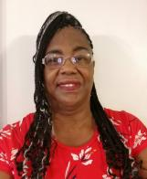
Team
Dorothy Richards,
Founder, CEO
30 years
Nutritionist
Patricia Smith, R.D., Ed.D.
COO
35 years
Professor of Nutrition & Health
Henry Pearson, ND
CFO
30 years
Natural Medicine
Notes:
Our team has over 100 years of experience in leadership and program development. Dorothy Richards, CEO who has 30 years of experience as a nutritionist, and Dr. Patricia Smith, COO who has 35 years experience as a licensed Dietician, and Dr. Henry Pearson, who has 30 years experience as a naturopath physician, and me who has 40 years experience in healthcare. We believe our team with their experience and backgrounds we can accomplish our goal of providing health access and health literacy through the S.M.A. R.T. Health Education at Home services.

Slide 9
Population
Health by Design currently serves the population of Winter Garden, Florida--Orange County-- comprised of about 43,500 persons (July 2017 U.S. Census).
Of the 43,500 persons, about 40% are minorities -- the largest percentages of which are:
25% Hispanic or Latino
15% Black or African American.

Slide 10
The Need
Health by Design provides healthcare education and health screening to poor and low-income individuals living in Winter Garden, Florida.
The program fills the need in the Winter Garden community by teaching individuals how to recognize the contributing factors associated with:
Obesity
Diabetes
Hypertension
Heart disease

Slide 11
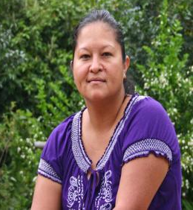
Customer
1 in 12 people uninsured
In Winter Garden
Women between ages of 55-64 highest percent of poverty (11.5%) compared to men at 6.77%
Notes:
Winter Garden is located in Central Florida and it has a population of 46, 000 people. Maria, a resident of Winter Garden was recently diagnosed with hypertension. She is uninsured and unsure how to manage her health condition.
Due to lack of insurance and lack of financial resources to seek medical treatment and education. Maria has struggled with severe health conditions because of delayed treatment, lack of monitoring equipment, limited financial resources, and poor self-management skills.

Slide 12
Problem
Access to affordable health care services is a factor that affects 5,000 uninsured individuals in the Winter Garden Community.
People experiencing health inequity often struggle with serious chronic conditions, comorbidities, and declining health.
Accessing health care services is difficult because of challenges with:
transportation
copays
health literacy.
Notes:
This problem exists because of:
Lack of transportation
Lack of healthcare education
Inability to pay copays
Social distancing
People without access to health services and with low health literacy are at risk of chronic diseases and shortened lifespans.

Slide 13
Desired Outcome
Primary
reduce incidences and improve the health of individuals diagnosed with chronic diseases, such as diabetes, obesity, heart disease and hypertension through nutrition education, physical activity and access to nutritious foods.
This program involves the delivery of a series of healthcare classes for a 12- month period.
Secondary
increase access to primary care by increasing education/awareness to health services.
.

Slide 15
Services
an average, we serve about 300 individuals annually using in-kind services and support.
Offer health classes with an in-depth curriculum.
Classes are designed to increase awareness of how individuals can take responsibility for improving their health and reducing barriers, given current financial and social conditions.
A presence at health fairs and community events with a “Wellness Bus” (mobile unit)

Slide 17
S.M.A.R.T. Health Education at Home Services
Self-Management, Awareness, Resources, Tele-health

Slide 18
S.M.A.R.T. Health at Home Services
Tele-Health Education at home.
Learn to Earn Resources
Meal Appeal Nutritious & Delicious Plant-based Meal Planning
Fitness Fun Move to Lose
Resources Map App and Referrals
Notes:
That is where our product can help! The S.M.A.R.T. program works by first reaching the individual at home virtually, then teaching self-management skills – meal appeal and fitness, next providing monitoring equipment, and finally developing a Resources Mobile Map App that empowers the individual to understand prevention and self-management of health conditions and to locate available resources.
Our services makes it easier! It features education, tracking biometic numbers, locating of health clinics, food banks, and fitness centers .

Slide 19
Program Schedule
Programs | Jan | Feb | Mar | Apr | May | Jun | Jul | Aug | Sept | Oct | Nov | Dec
Weight Management
Fitness
Diabetes
Cardiac Health/ Hypertension
Nutrition
Stress Management

Slide 20
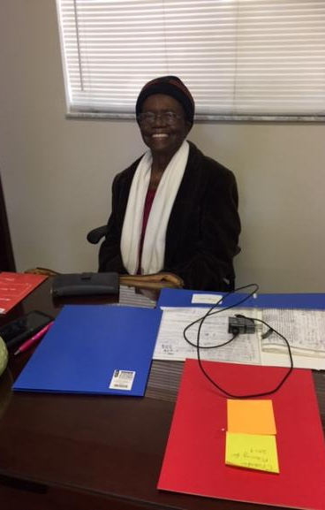
Classes
Classes meet once a week for either 6 or 8 weeks.
A minimum of 10 participants needed for each class and a maximum of 25, so we can provide individual attention and assistance to participants.
All classes will be two-hour sessions and include a health assessment during the class.
Some classes include a personal trainer and/or food preparation demonstration.

Slide 21
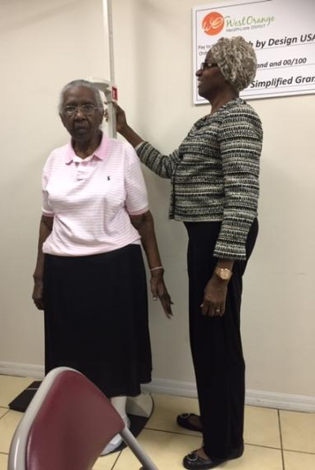
Classes
Initial and End of Class Health Assessment includes biometric measurements as follows:
cardiovascular profile with cholesterol check
diabetes glucose check
blood pressure check
weight/height, BMI (body mass index)
Health Assessments: Screening results will be reviewed by qualified health professionals.

Slide 22
Classes
In-Class
Establish personal goals
Self-tracking of measurements
Post-Class
Graduation
On-going follow-up with qualified health professionals, monthly.

Slide 23
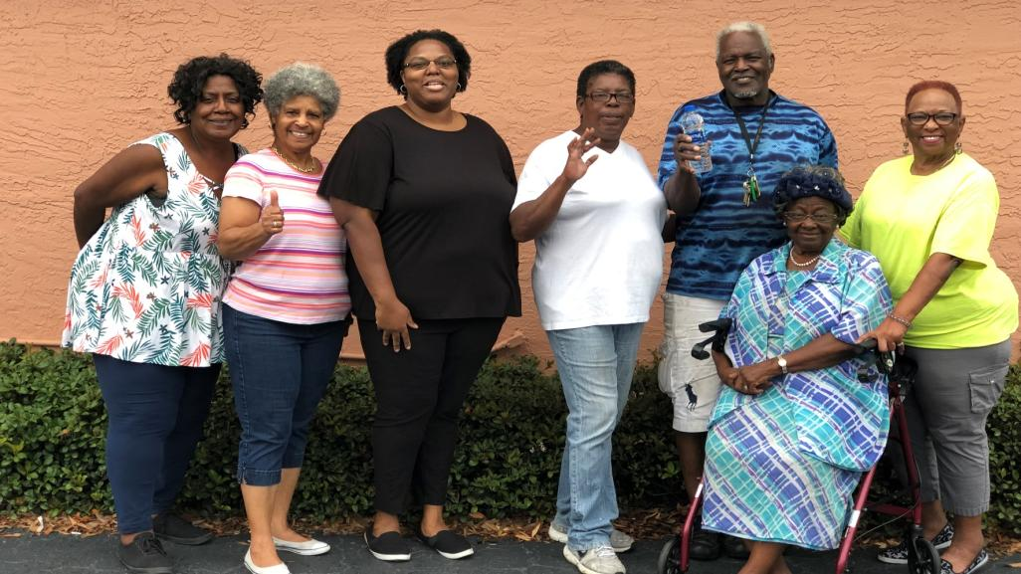
Fitness Fun

Slide 24
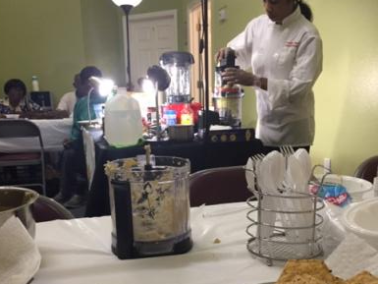
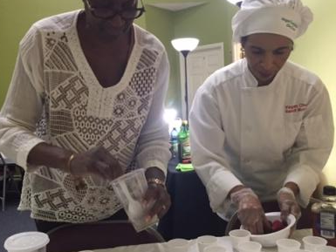
Meal Appeal – Cooking Classes

Slide 25
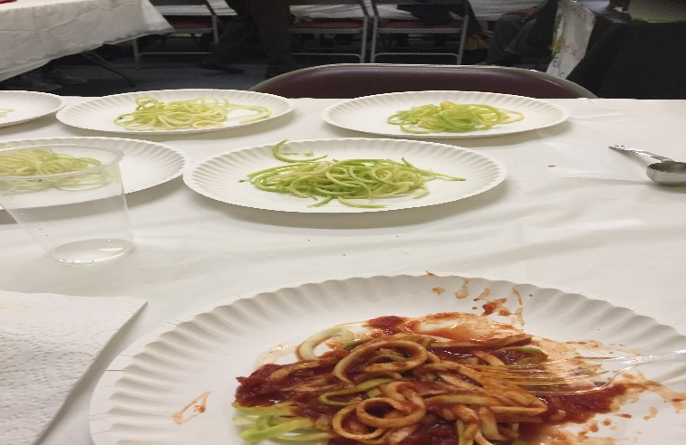
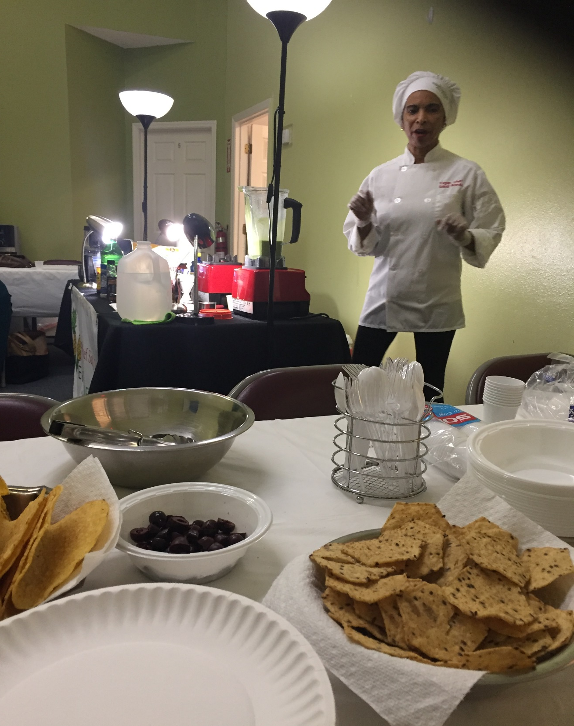
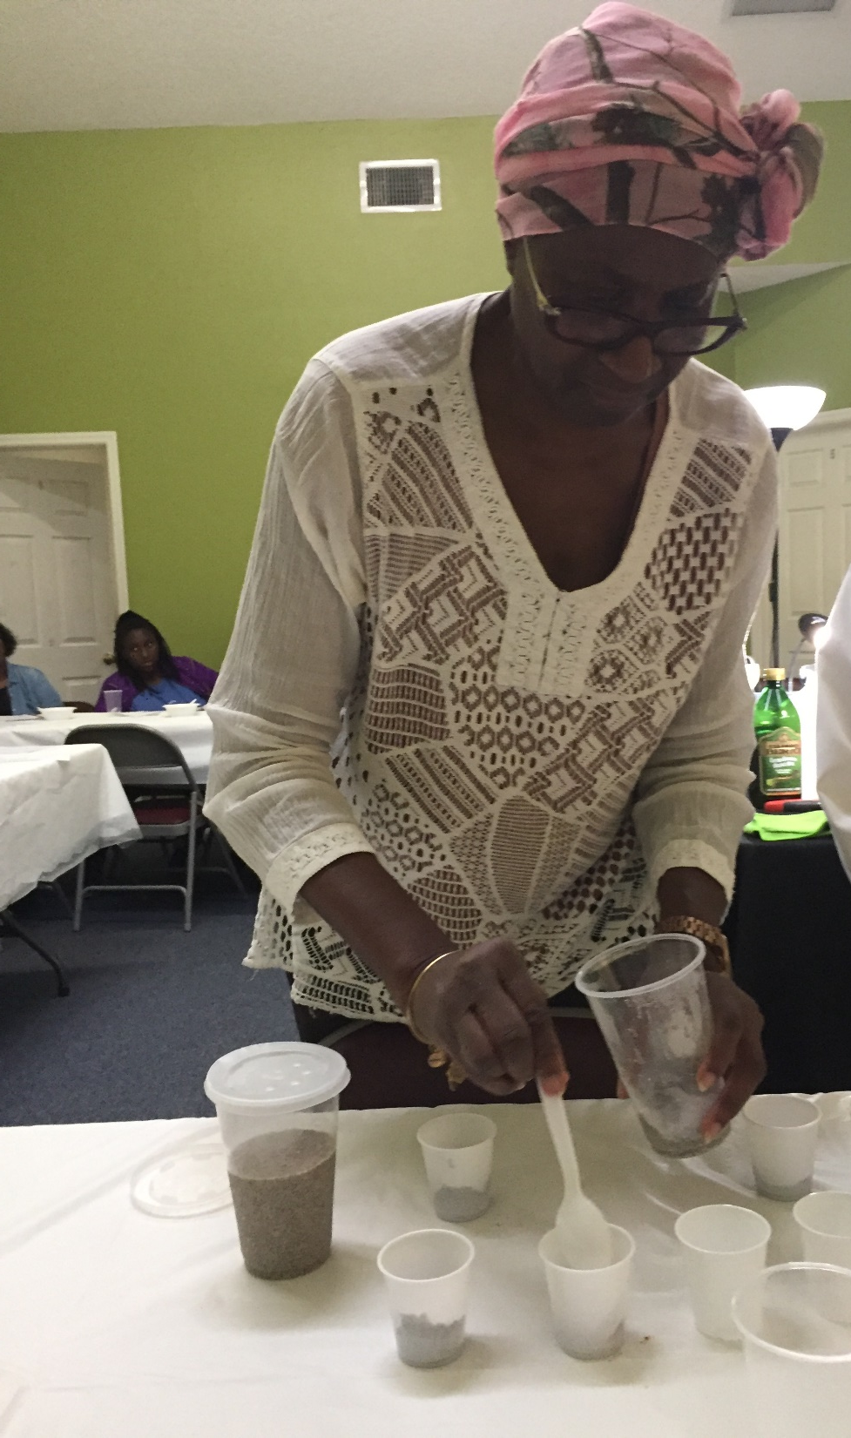
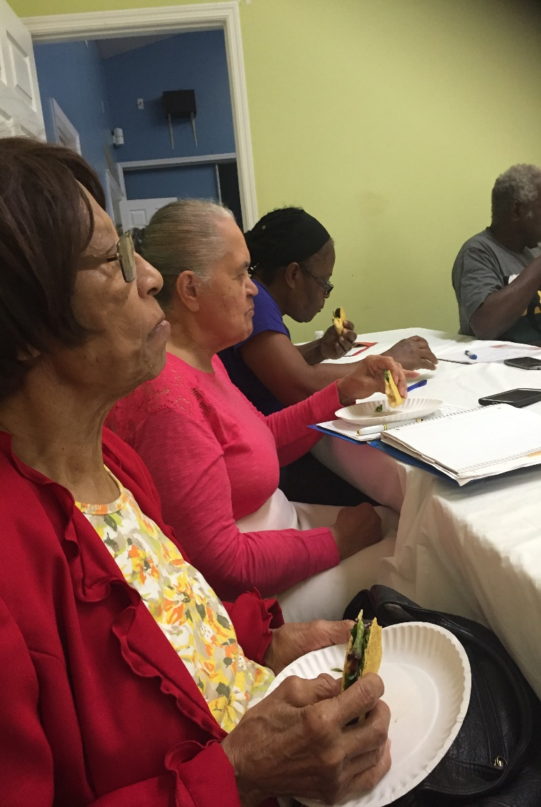

Slide 26
Learn to Earn Resources

Slide 27
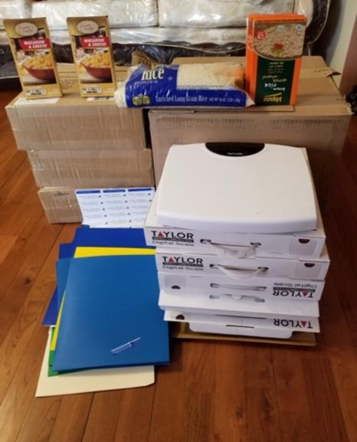
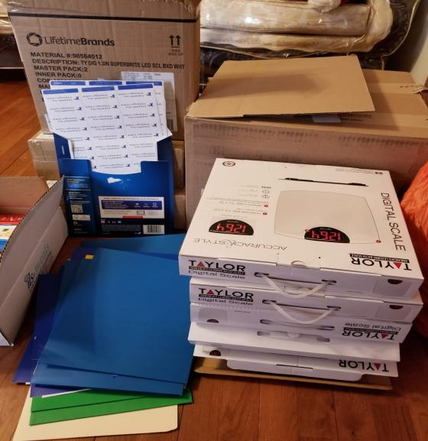

Slide 28
Social Impact
Percentage of participants enrolled in education classes that met their lifestyle goals was 90%. Lower blood pressure readings Reduction in blood glucose readings Decrease in body weight and BMI by 10 lbs.
Notes:
Since 2011, Health by Design USA, Inc has provided access to health services to over 4,500 individuals.

Slide 29
Community Events

Slide 30
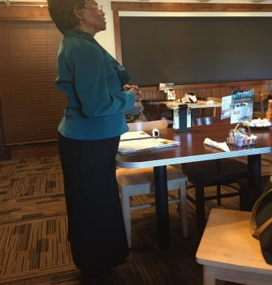
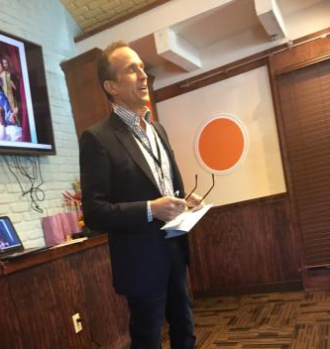
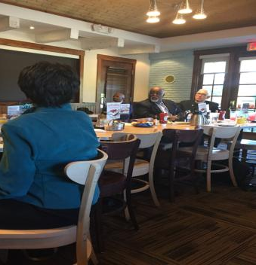
Pastor’s Appreciation Breakfast

Slide 31
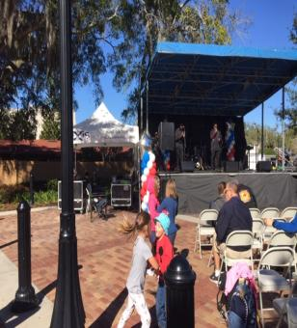
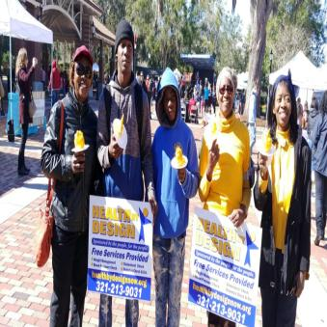
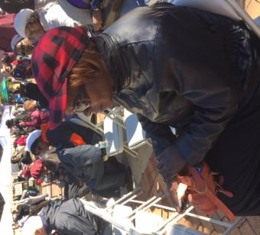
Martin Luther King Parade

Slide 32
Annual Banquet

Slide 33
2021 Events

Slide 36
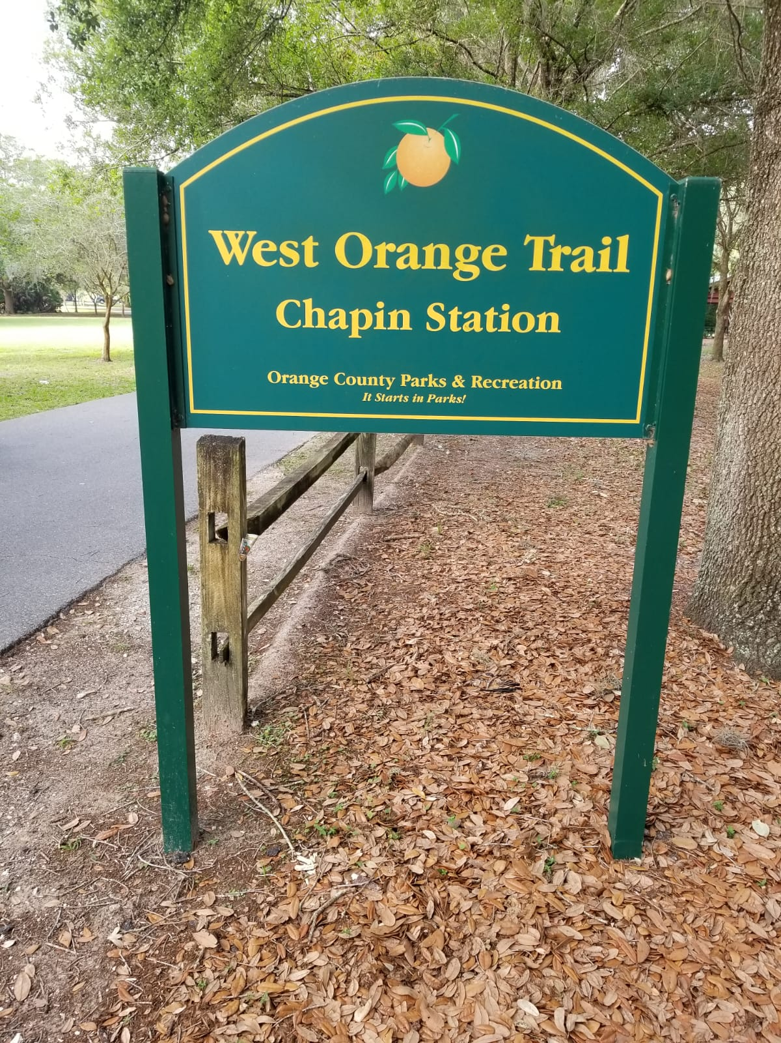

Slide 37
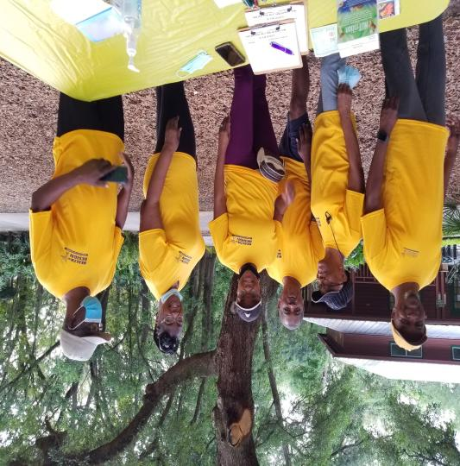
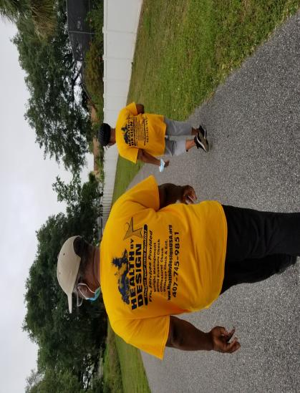

Slide 39
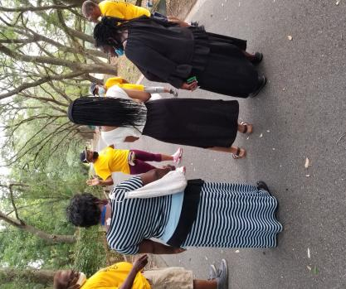
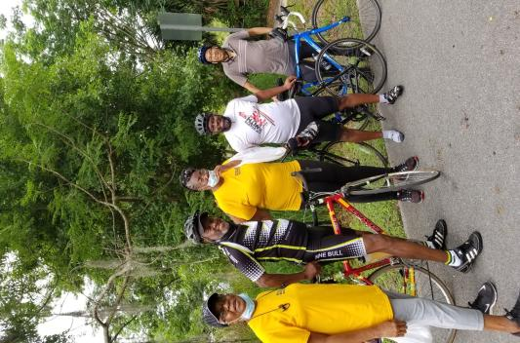
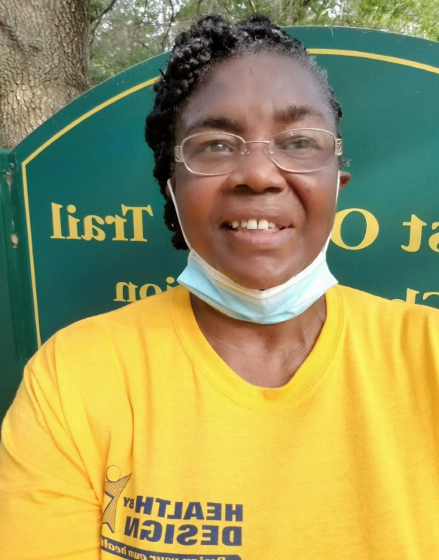

Slide 42
Participation in Community Events Dr. Martin Luther King Jr. Parade 2022

Slide 43
Resources

Slide 44
Needs
V.I.P.
Volunteers
Income/donations
Participants for classes
Partners/Grants/Sponsors
Internet Infra structure/hot spots
Computers, tablets, cell phones

Slide 45
Volunteers Needed
Clerical support
Secretary
Follow-up phone calls
Nursing support
Photographer/social Media
Bus Drivers
Community Liaisons
Transportation
Marketing/Advertising
Helping Hands
Event planner

Slide 46
Financial/Sponsors
Health by Design has sustained itself through community support.
For over seven years, Health by Design has successfully provided community service programs using individual and corporate donations and sponsorships, in-kind services and fundraising income.
West Orange Healthcare District

Slide 47
Appreciation of Volunteers

Slide 48
Questions

Slide 49
Thank You

