Slide 1
Health by Design USA Inc. Health Screening.

Slide 2
Youths assisted in giving out health related information (goodie bags) to the East Winter Garden Community.

Slide 3
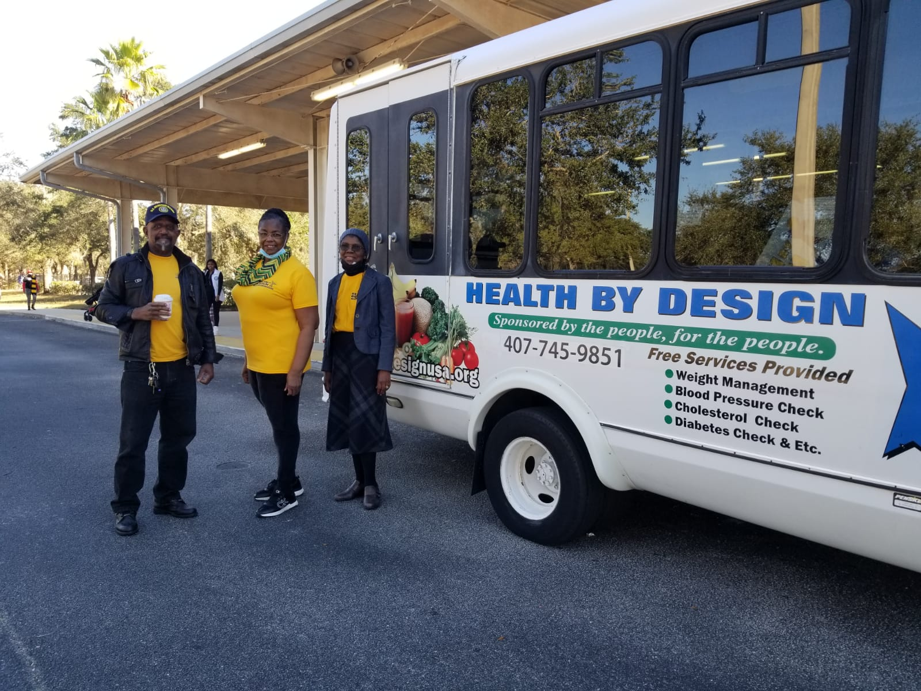

Slide 4
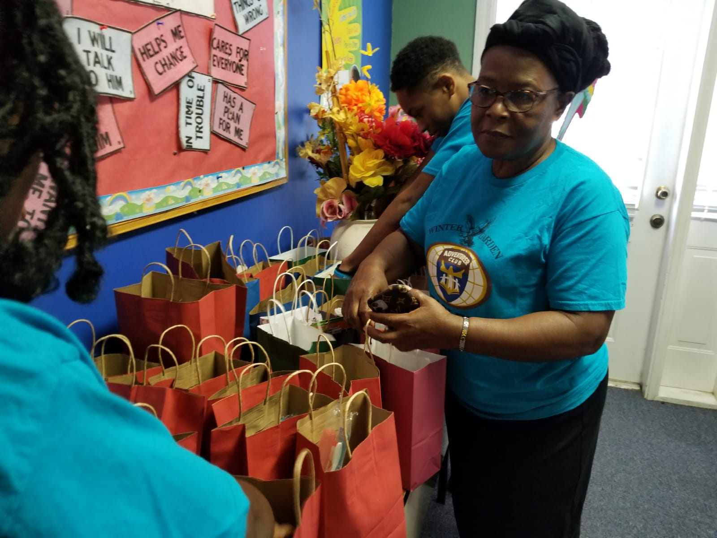
Preparing health related information (goodie bags) for the East Winter Garden Community.

Slide 5
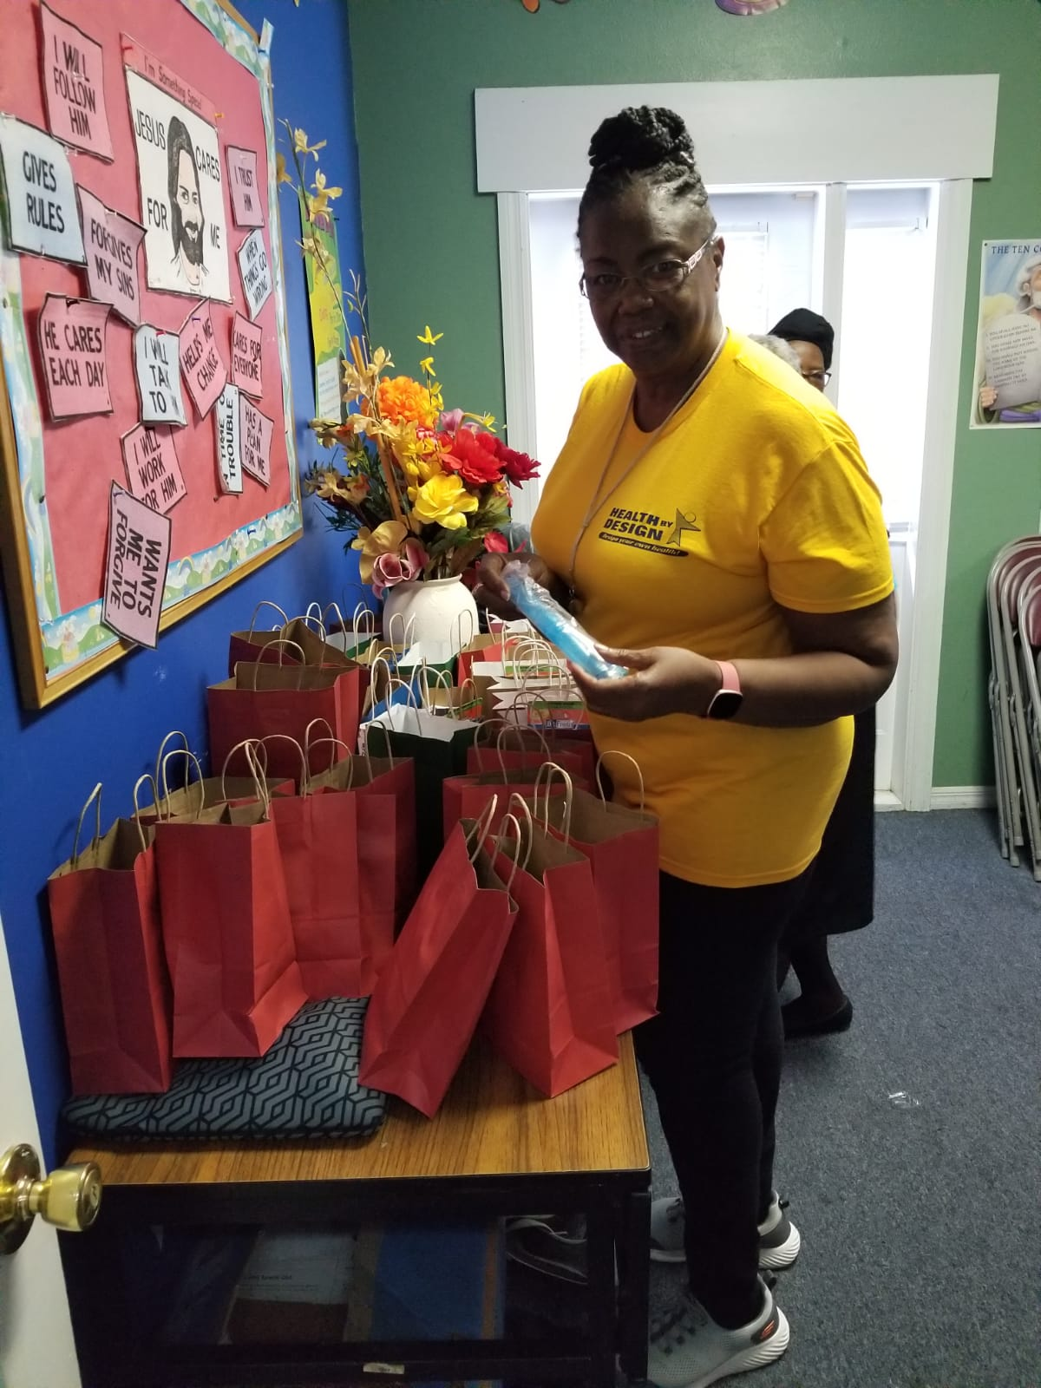
Preparing health related information (goodie bags) for the East Winter Garden Community.

Slide 6
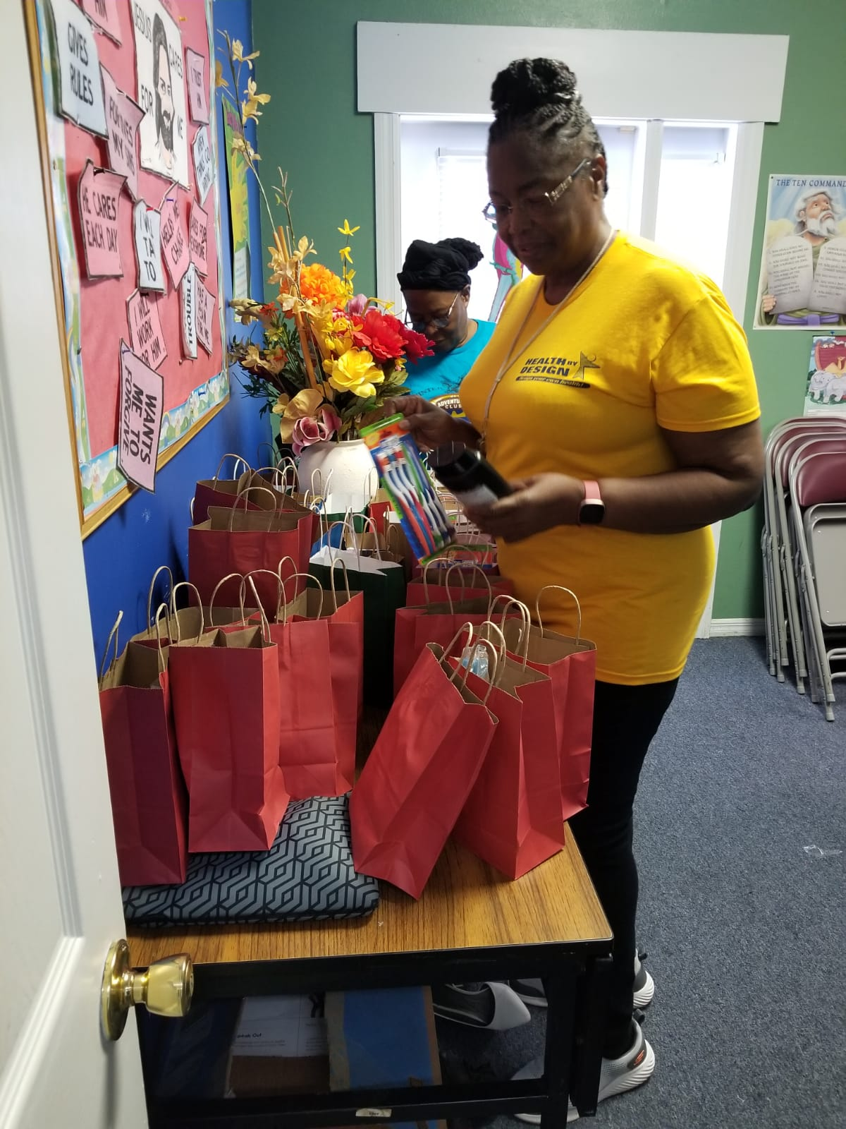

Slide 7
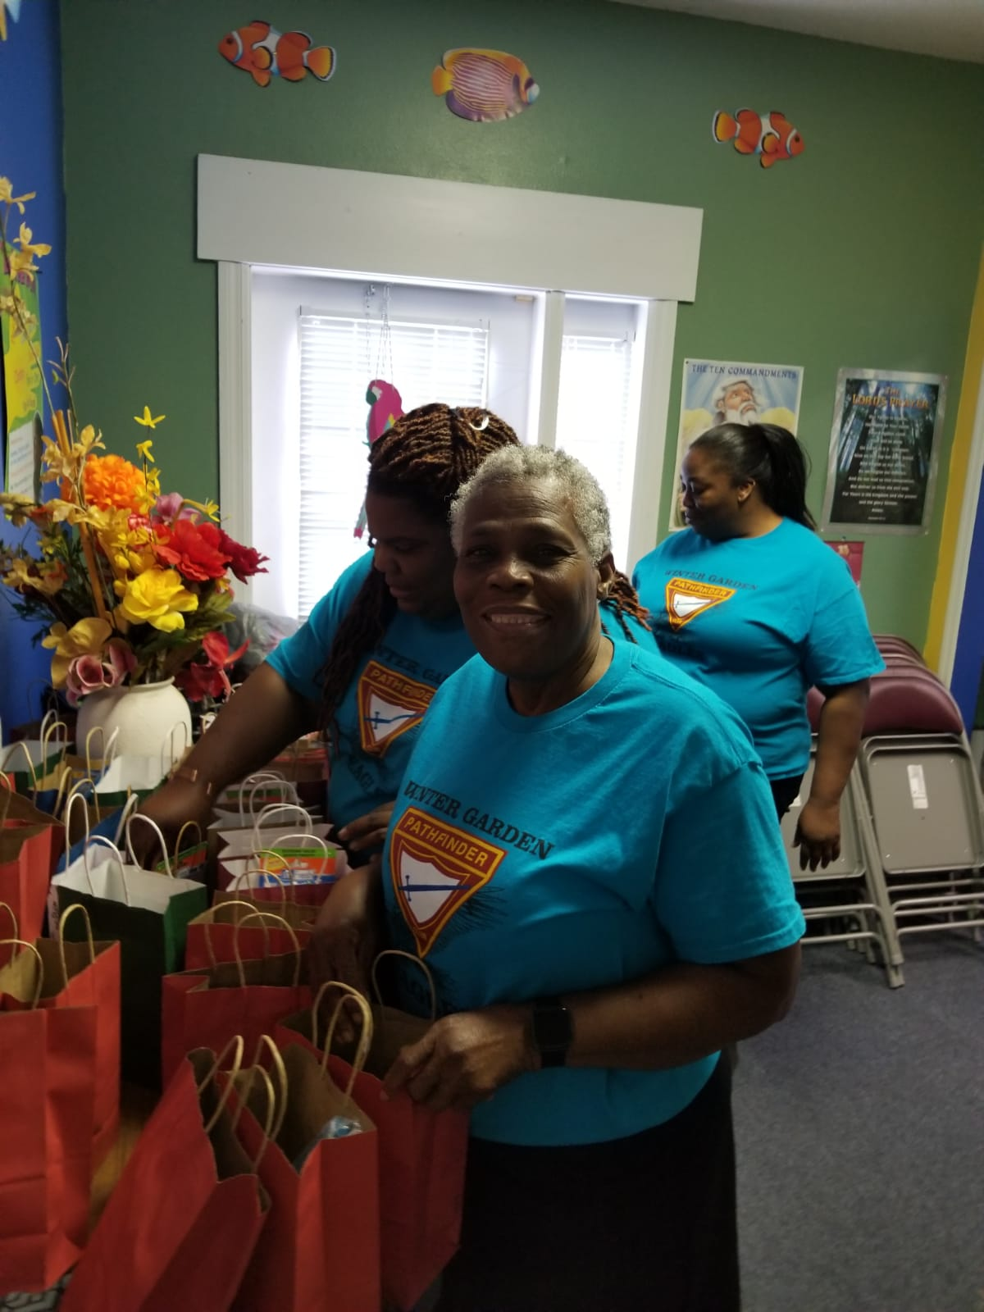

Slide 8
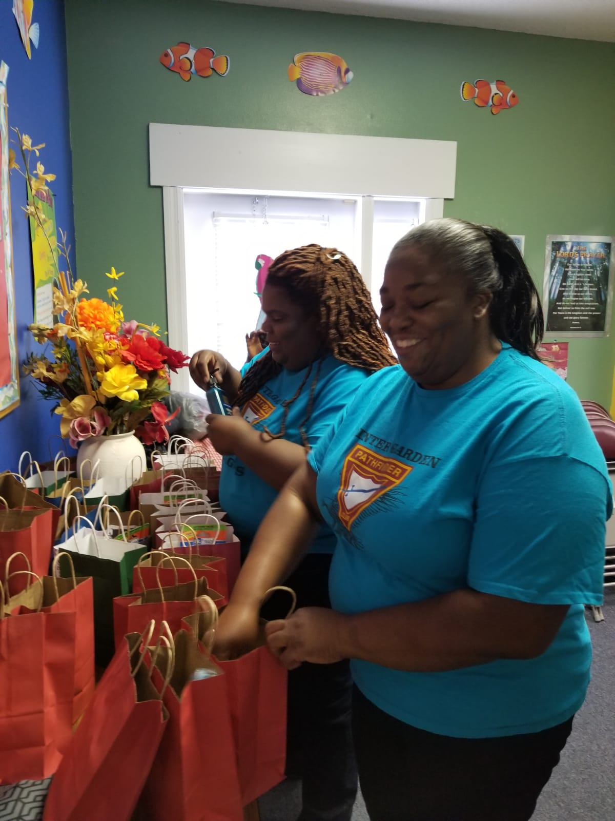

Slide 9
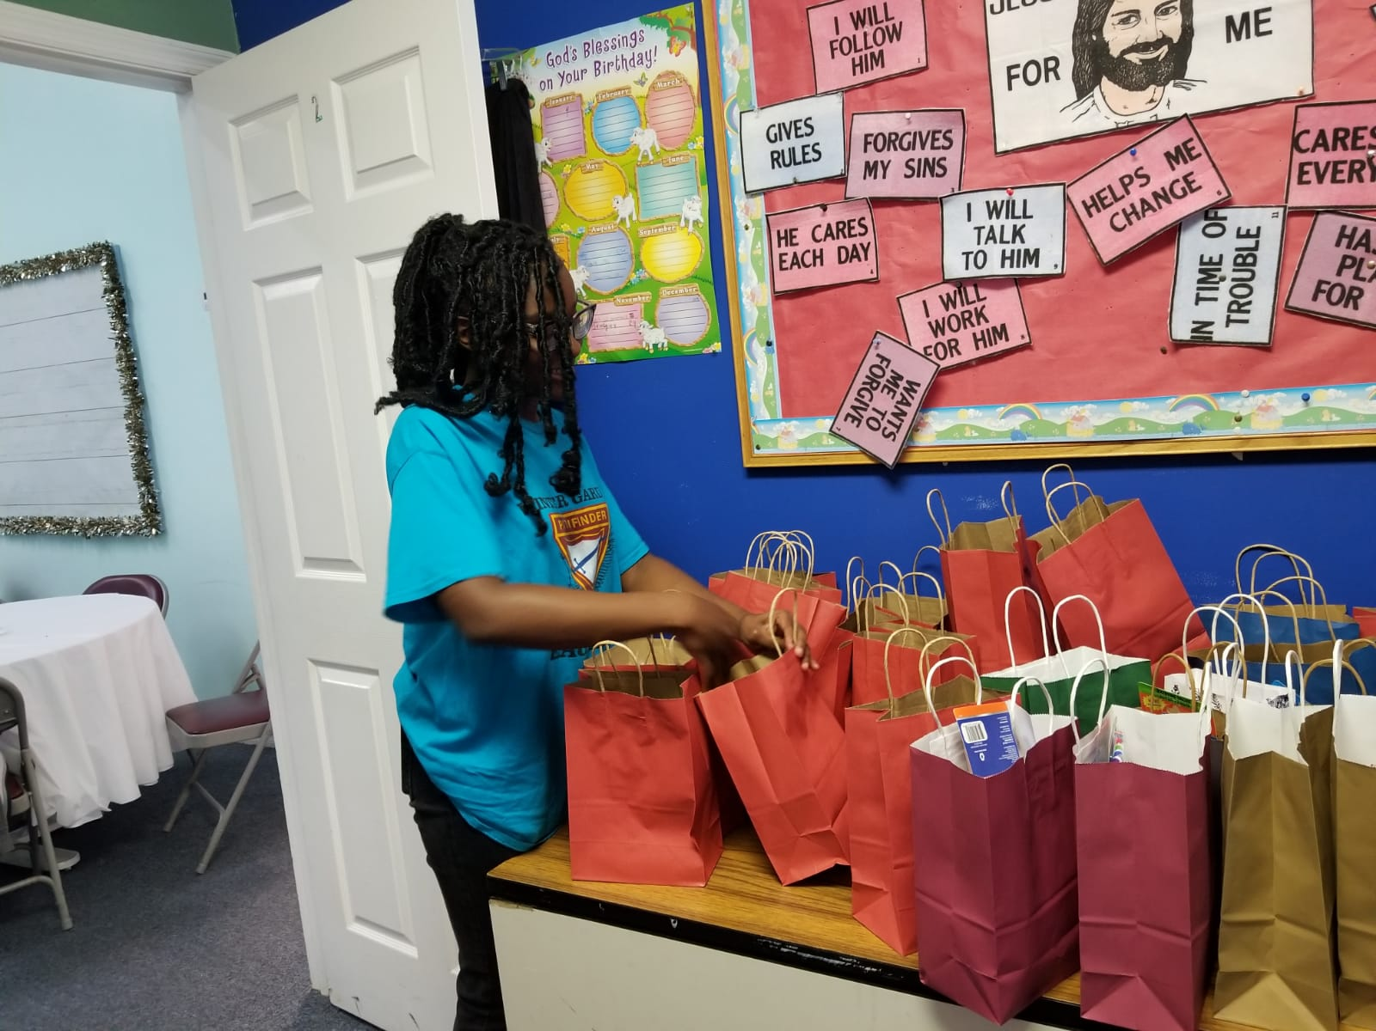
Youths assisted in giving out health related information to the East Winter Garden Community.

Slide 10
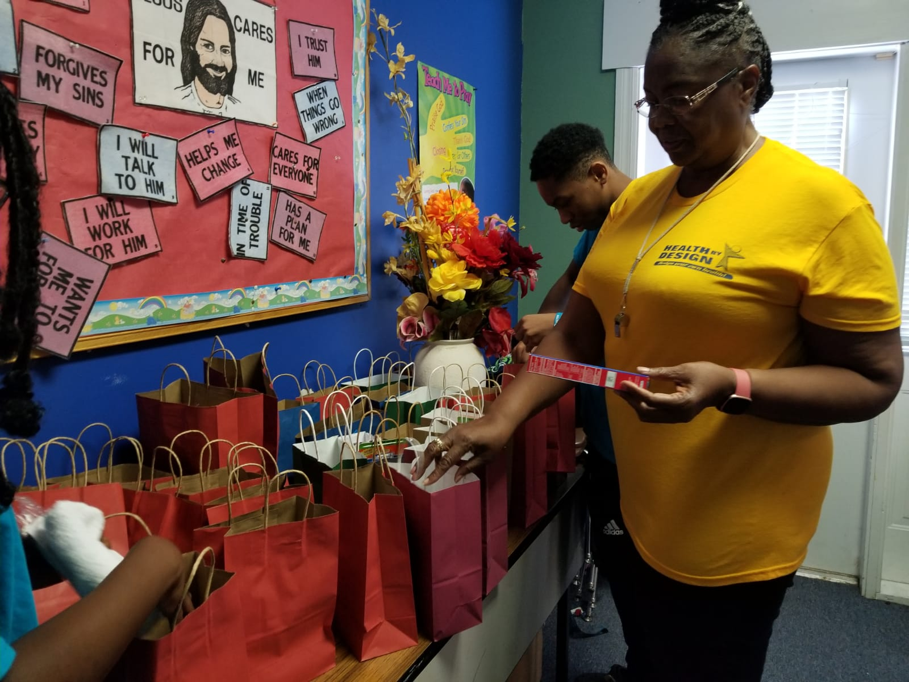

Slide 11
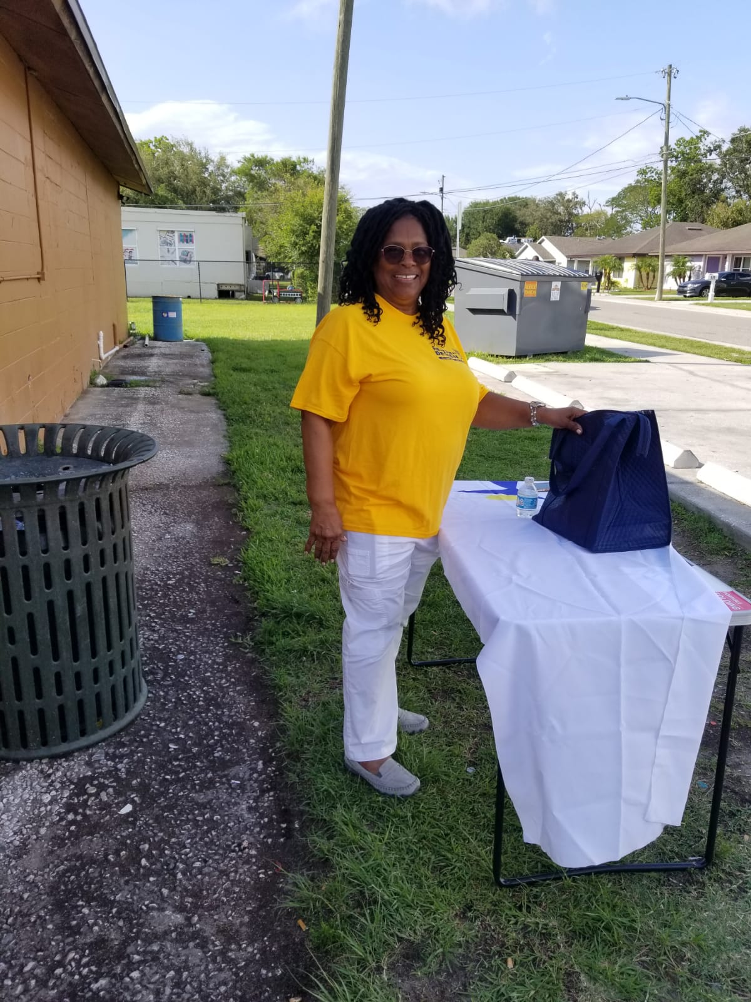

Slide 12
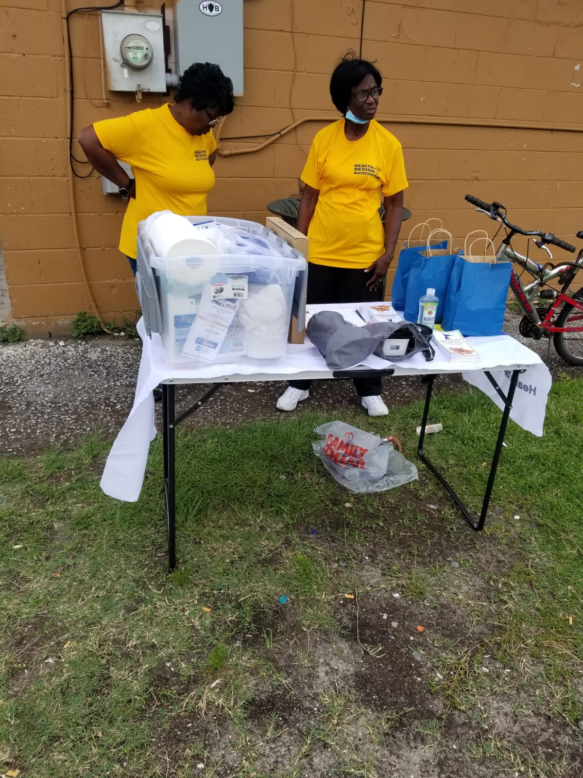

Slide 13
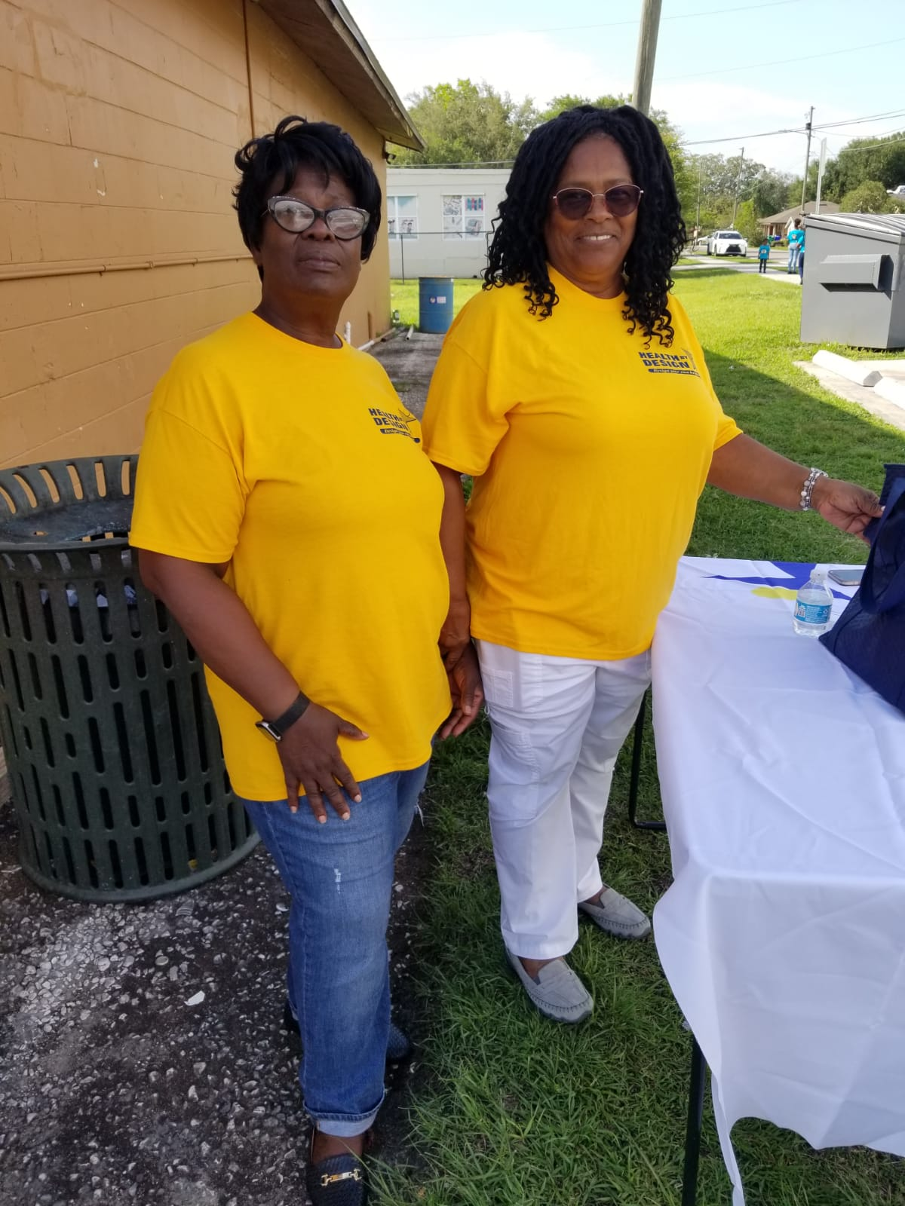

Slide 14
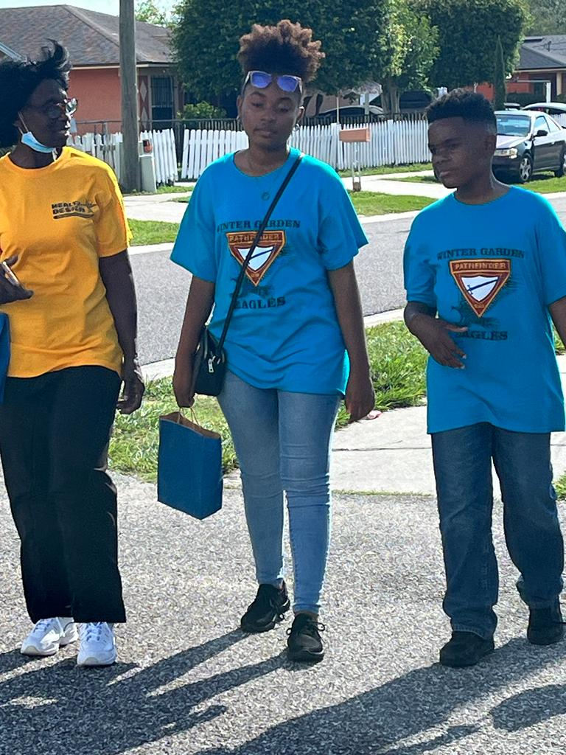
Youths assisted in giving out health related information to the East Winter Garden Community.

Slide 15
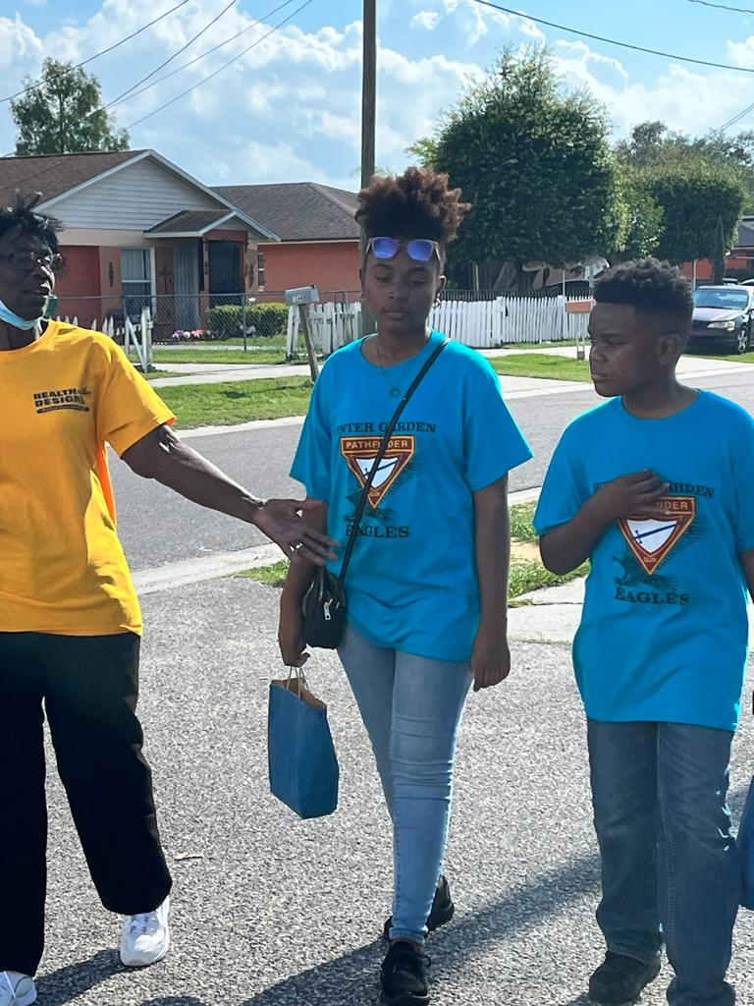
Youths assisted in giving out health related information (goodie bags) to the East Winter Garden Community.

Slide 16
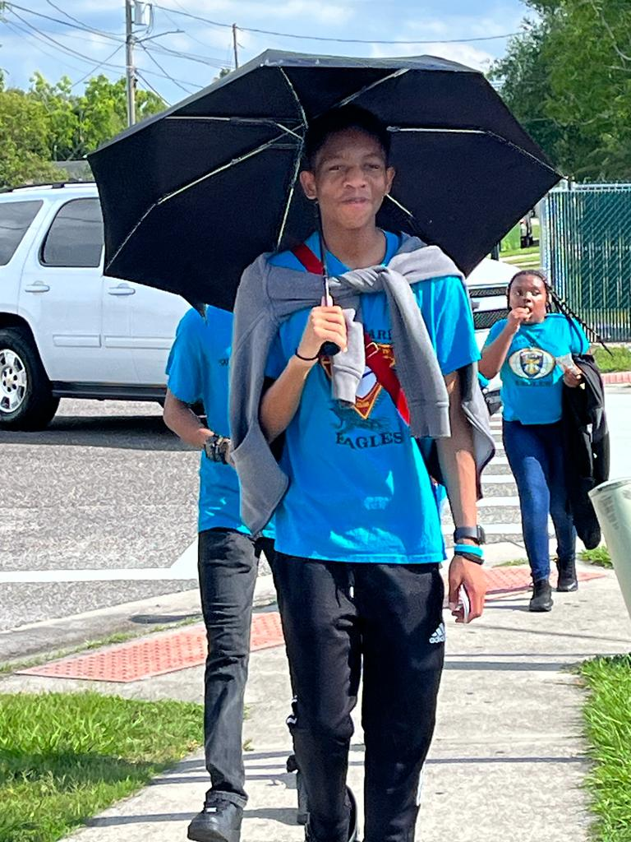
ouths assisted in giving out health related information (goodie bags) to the East Winter Garden Community.

Slide 17
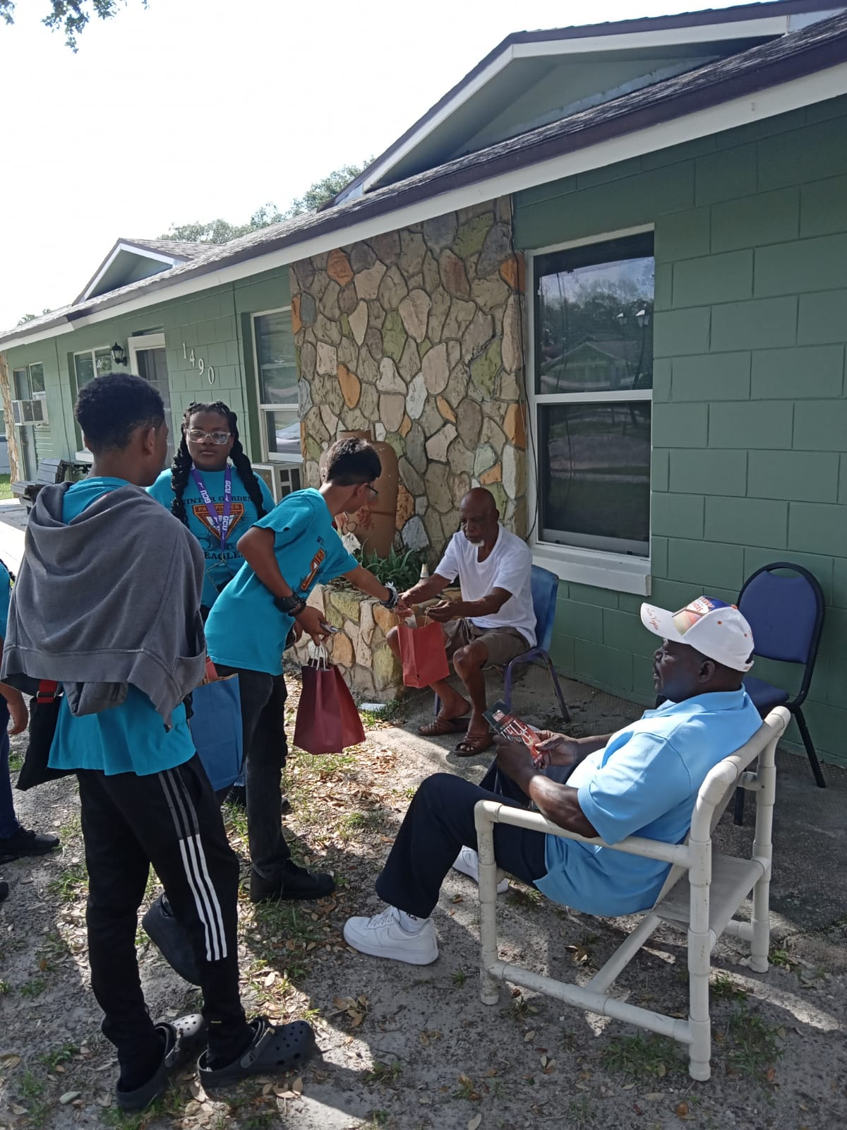

Slide 18
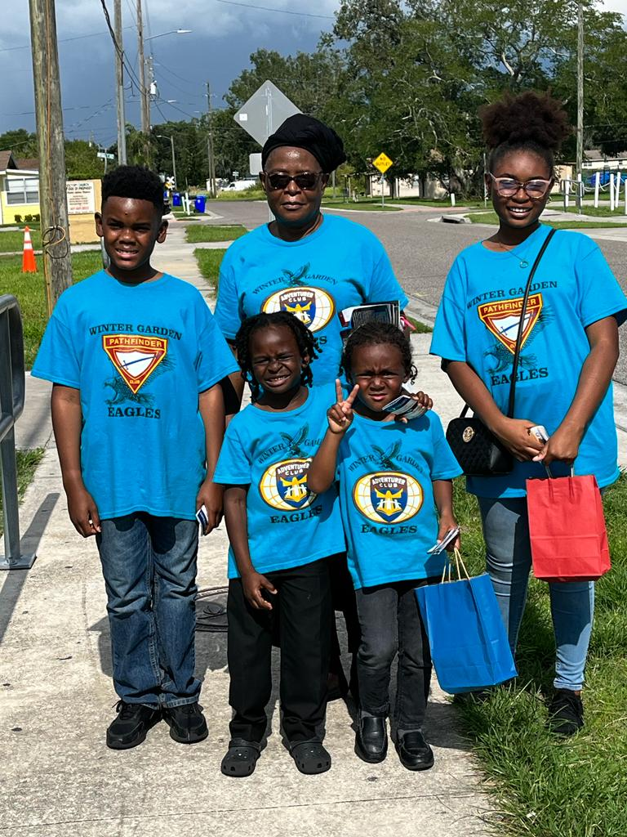

Slide 19
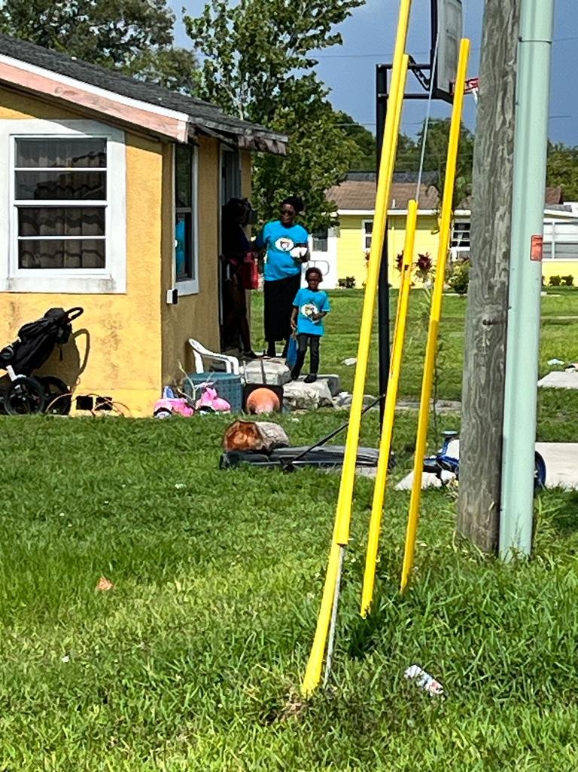

Slide 20
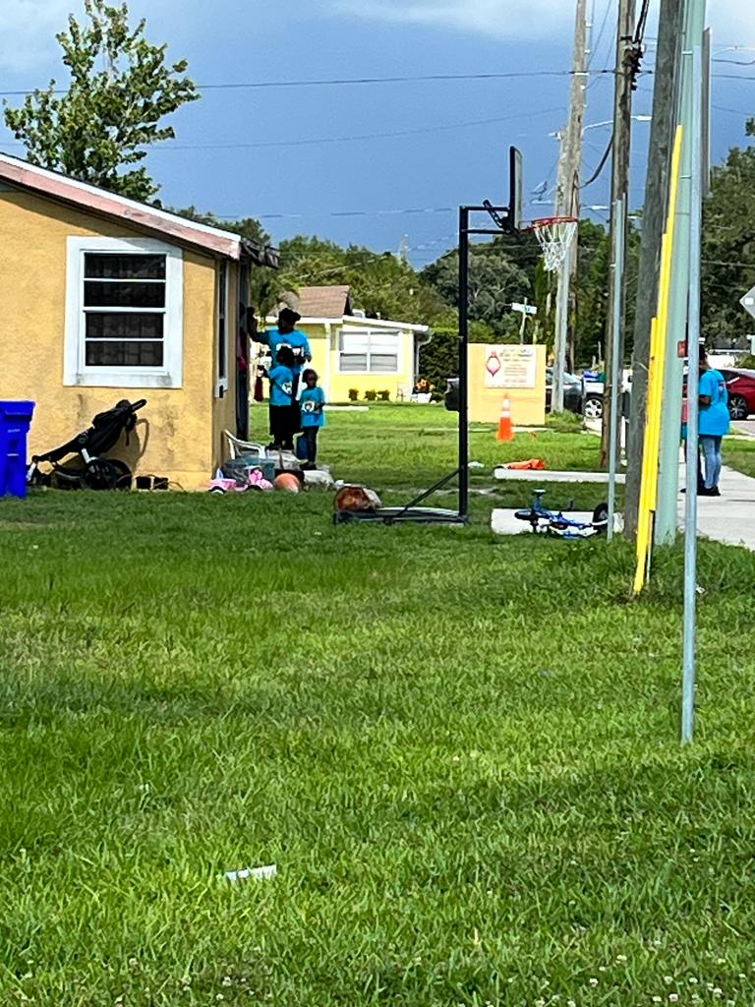

Slide 21
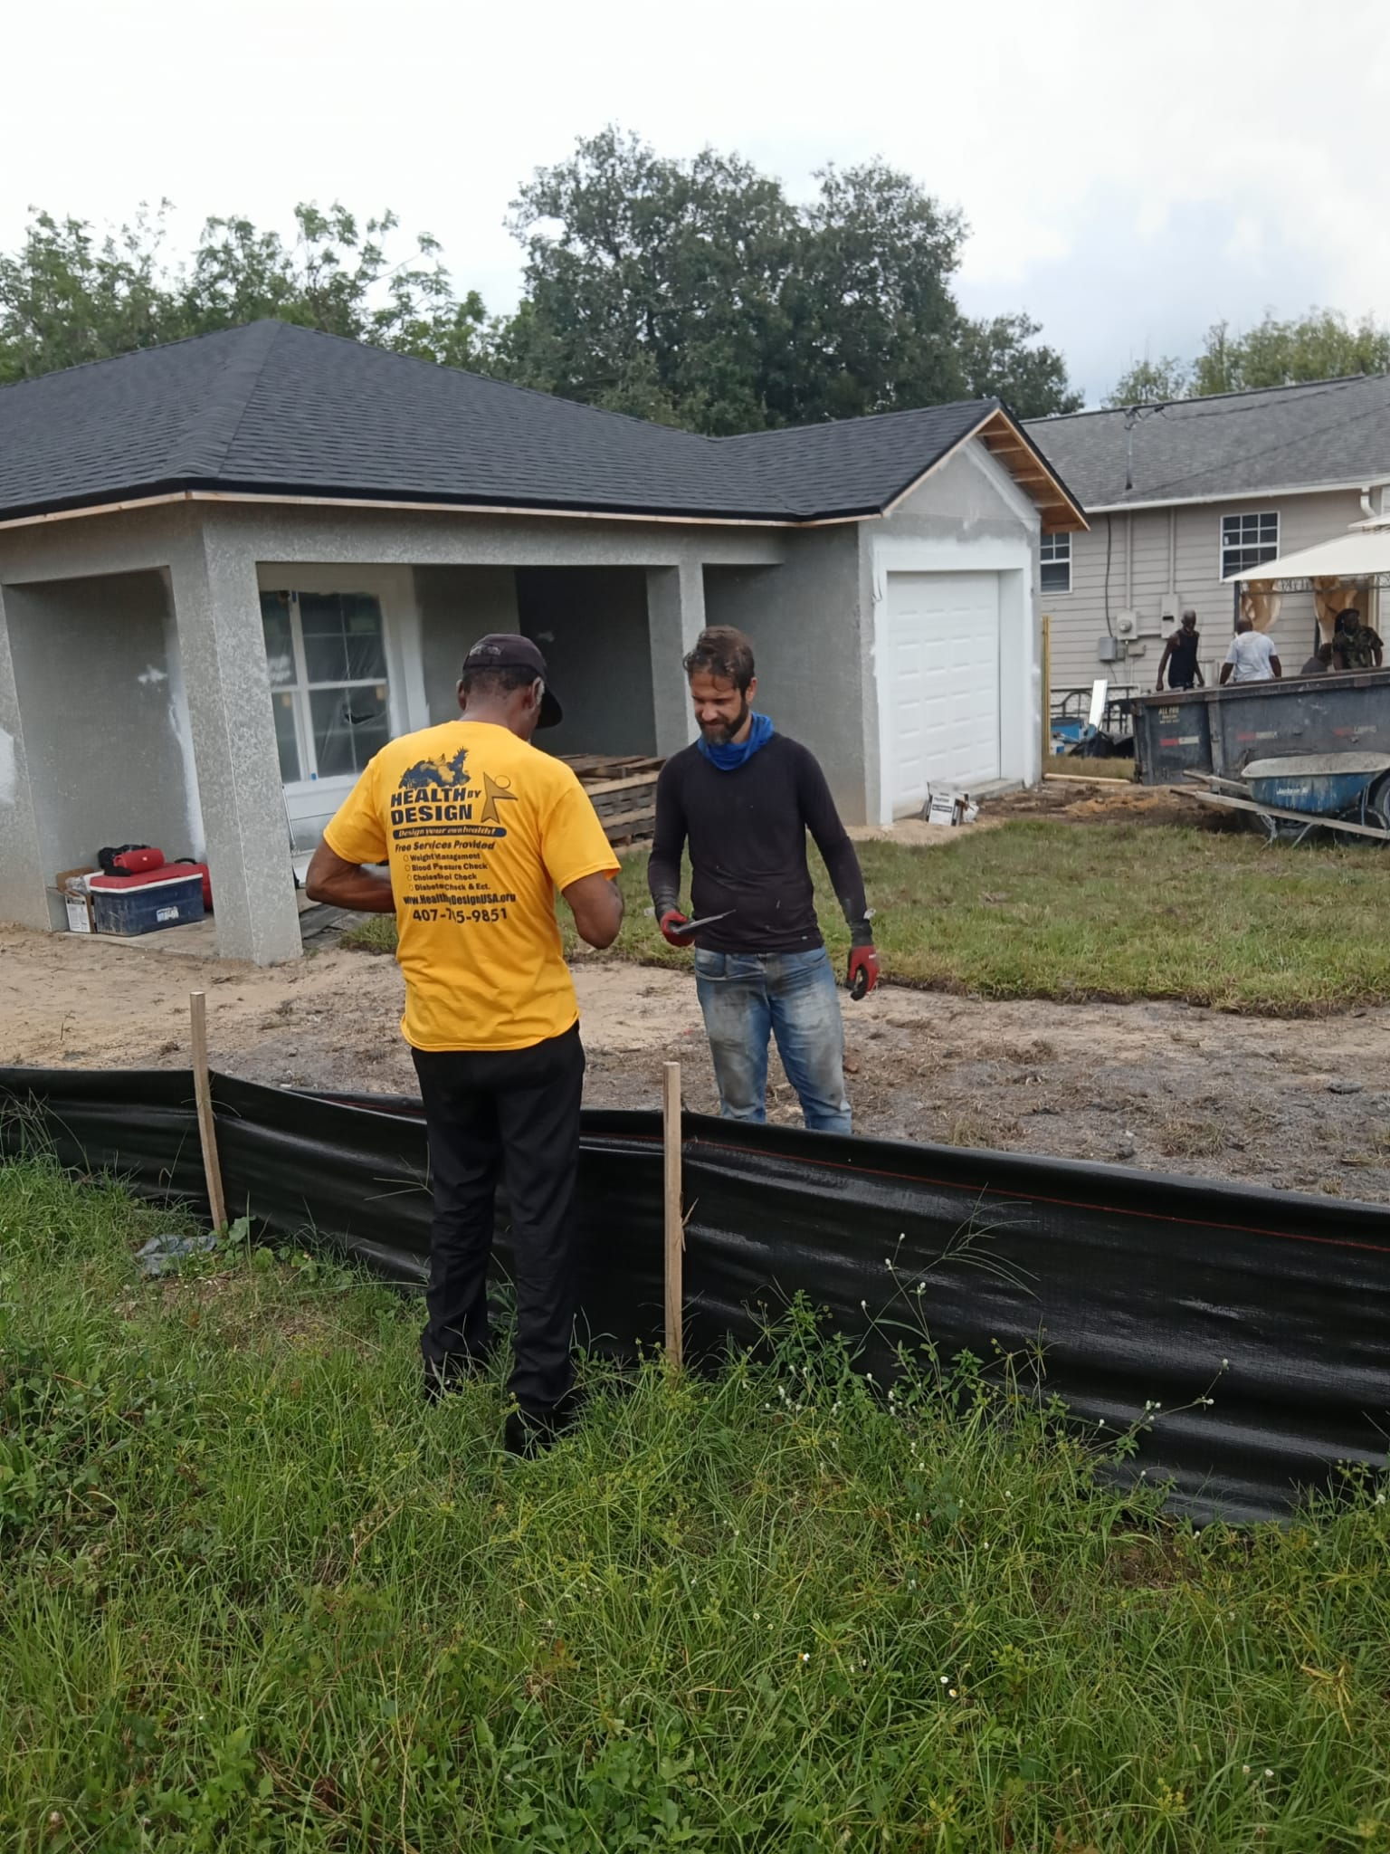

Slide 22
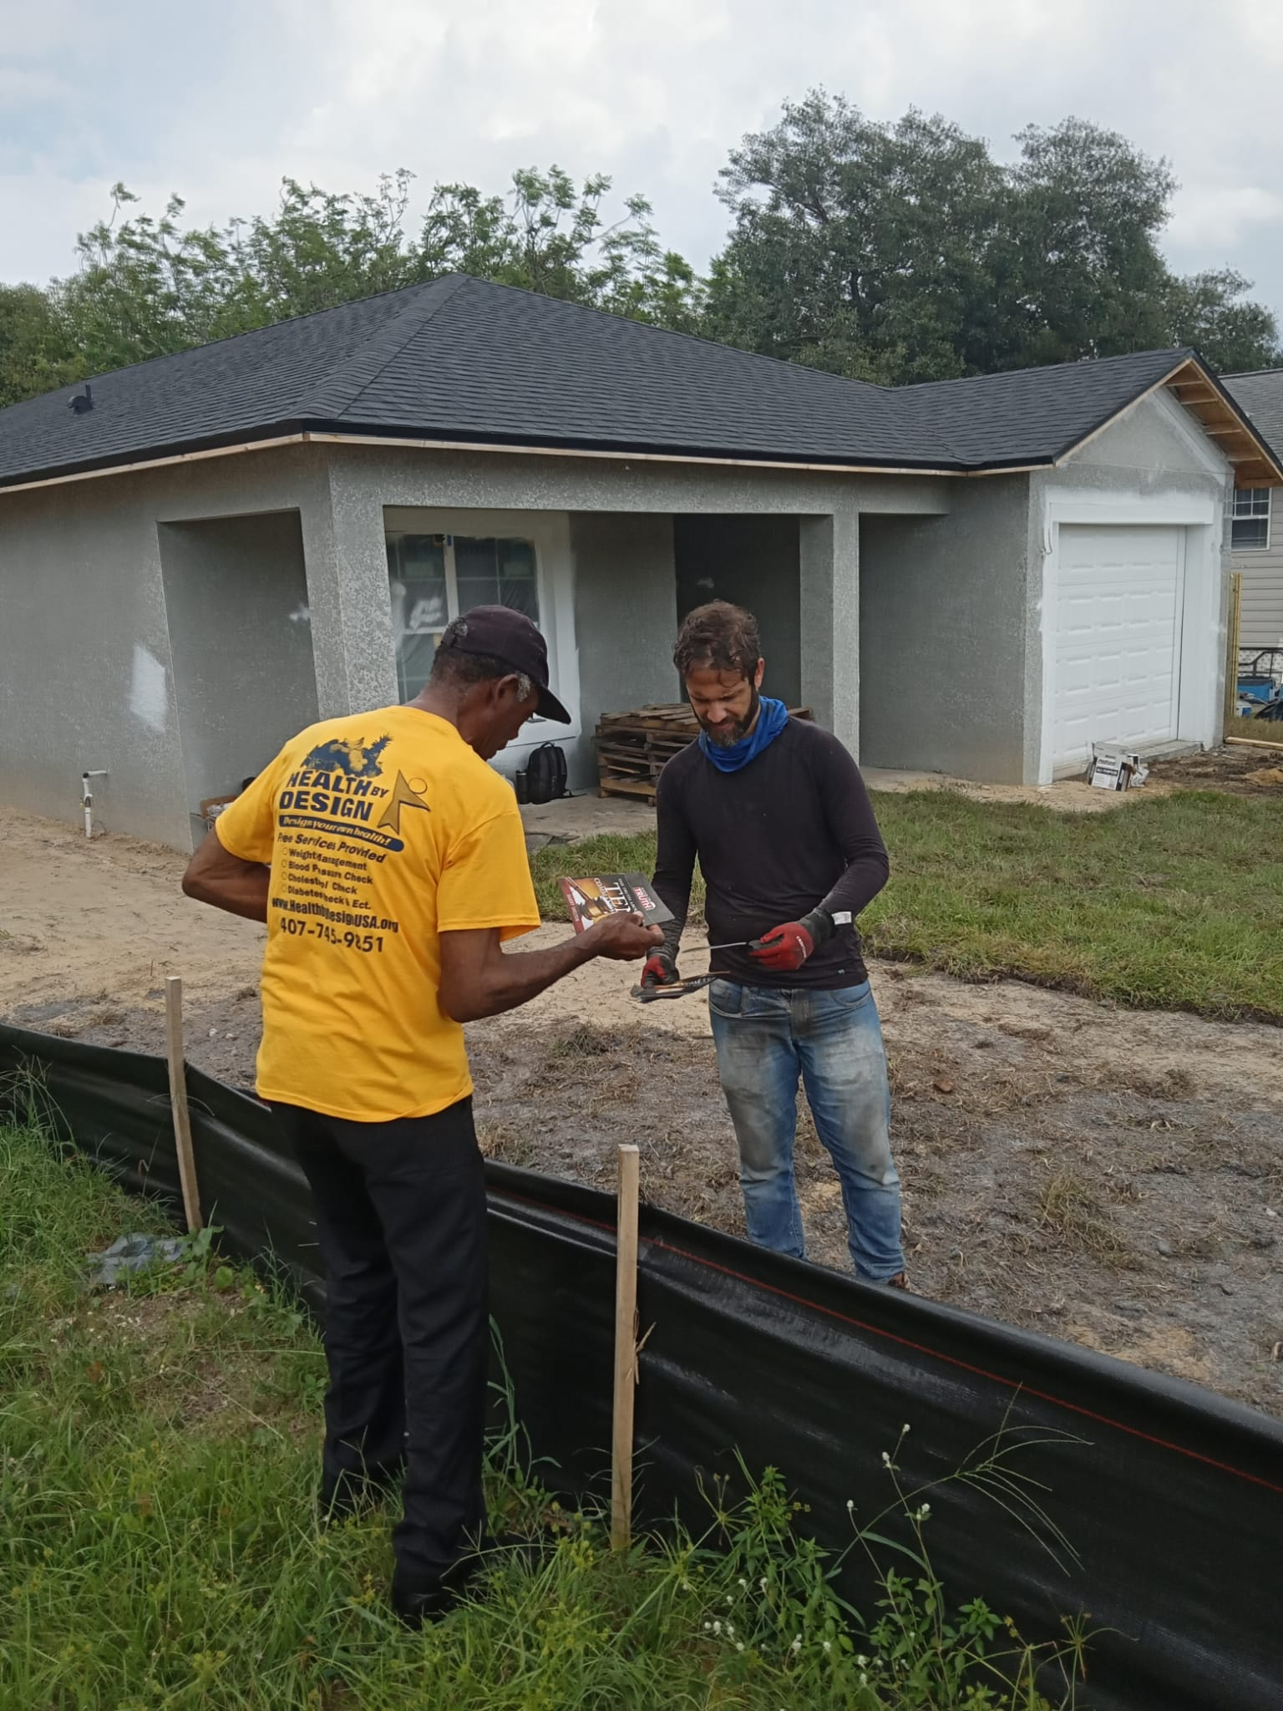

Slide 23
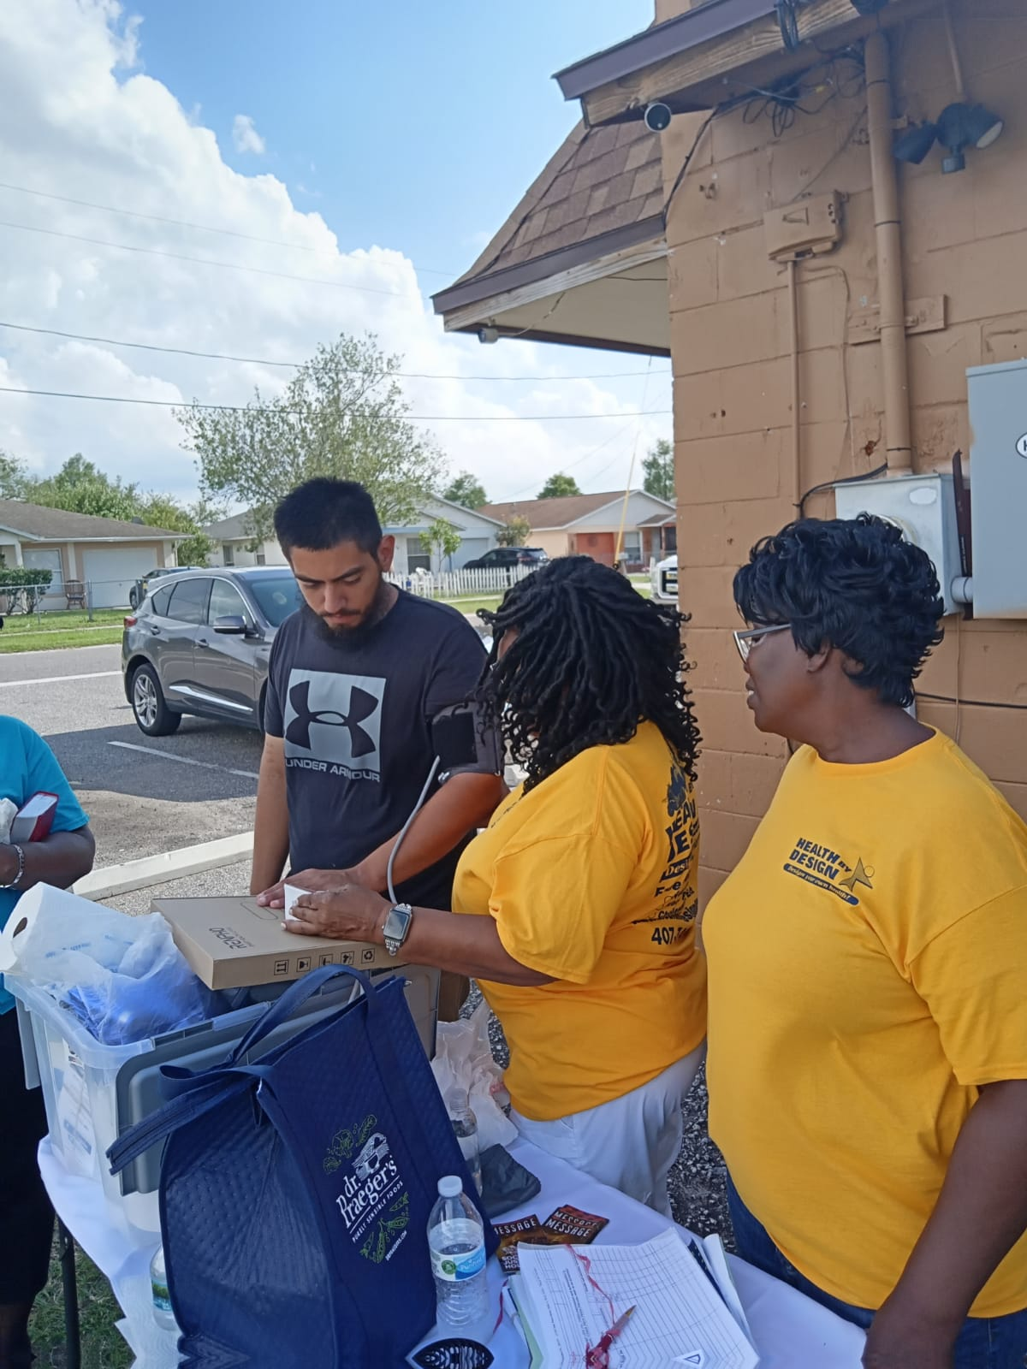
Blood Pressure screening/education in the East Winter Garden Community.

Slide 24
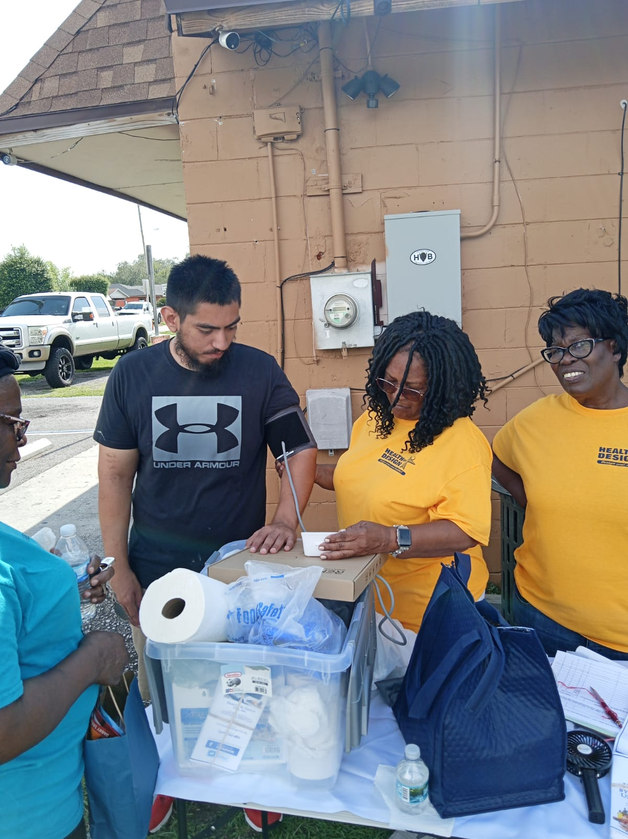
Blood Pressure Screening/education in the East Winter Garden Community.

Slide 25
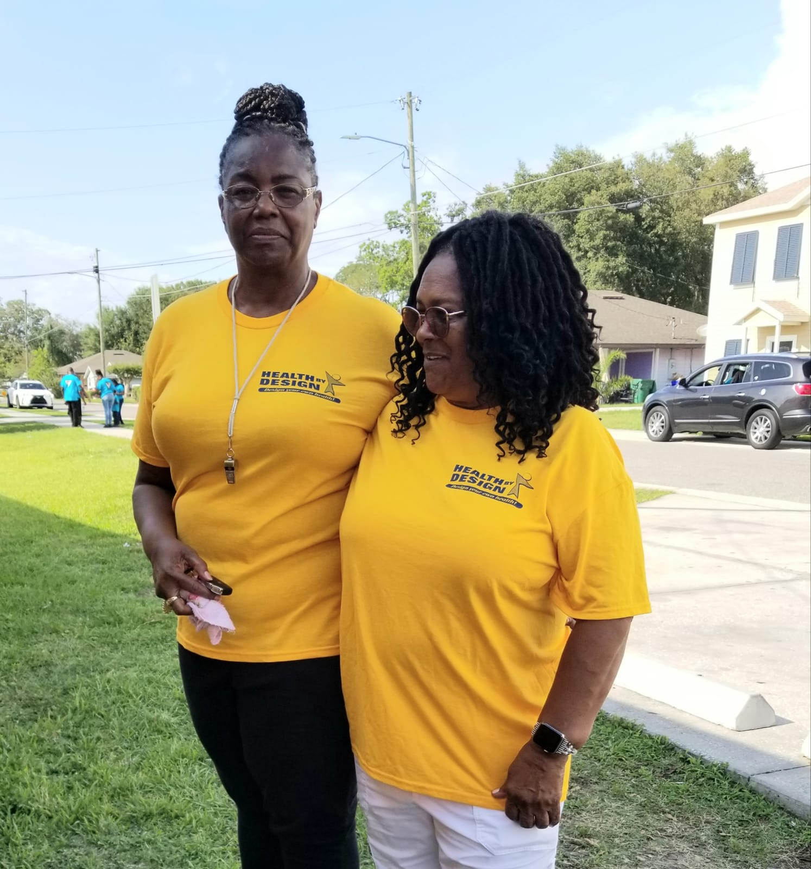

Slide 26
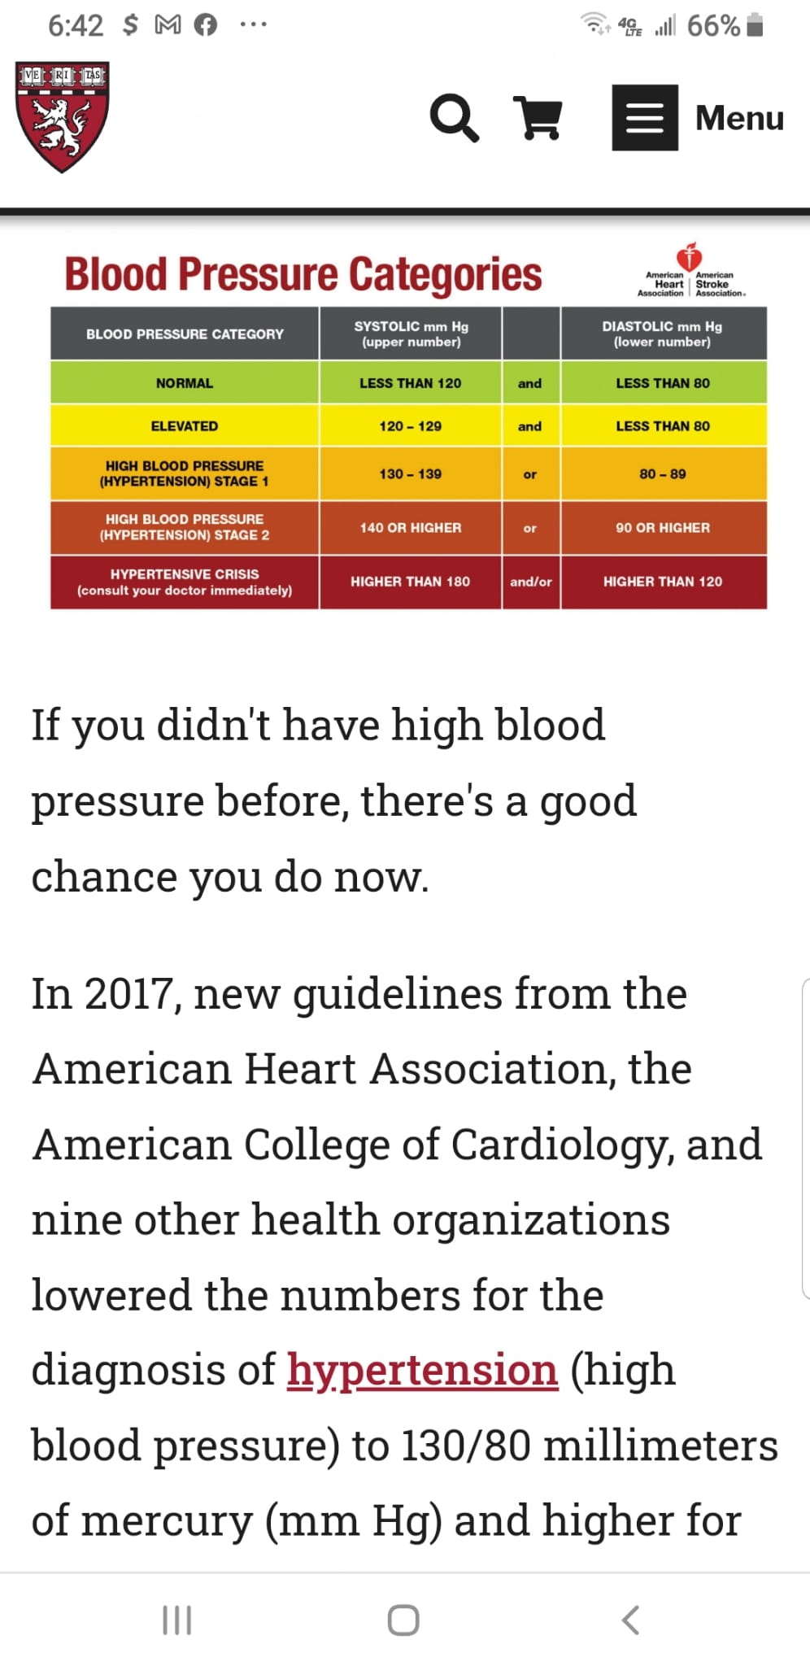

Slide 27
Health by Design USA Inc. advertises health-related online classes

Slide 28
Health by Design USA Inc. advertises health-related online cooking classes with Vegan Celebrity chef Sandi.

Slide 29
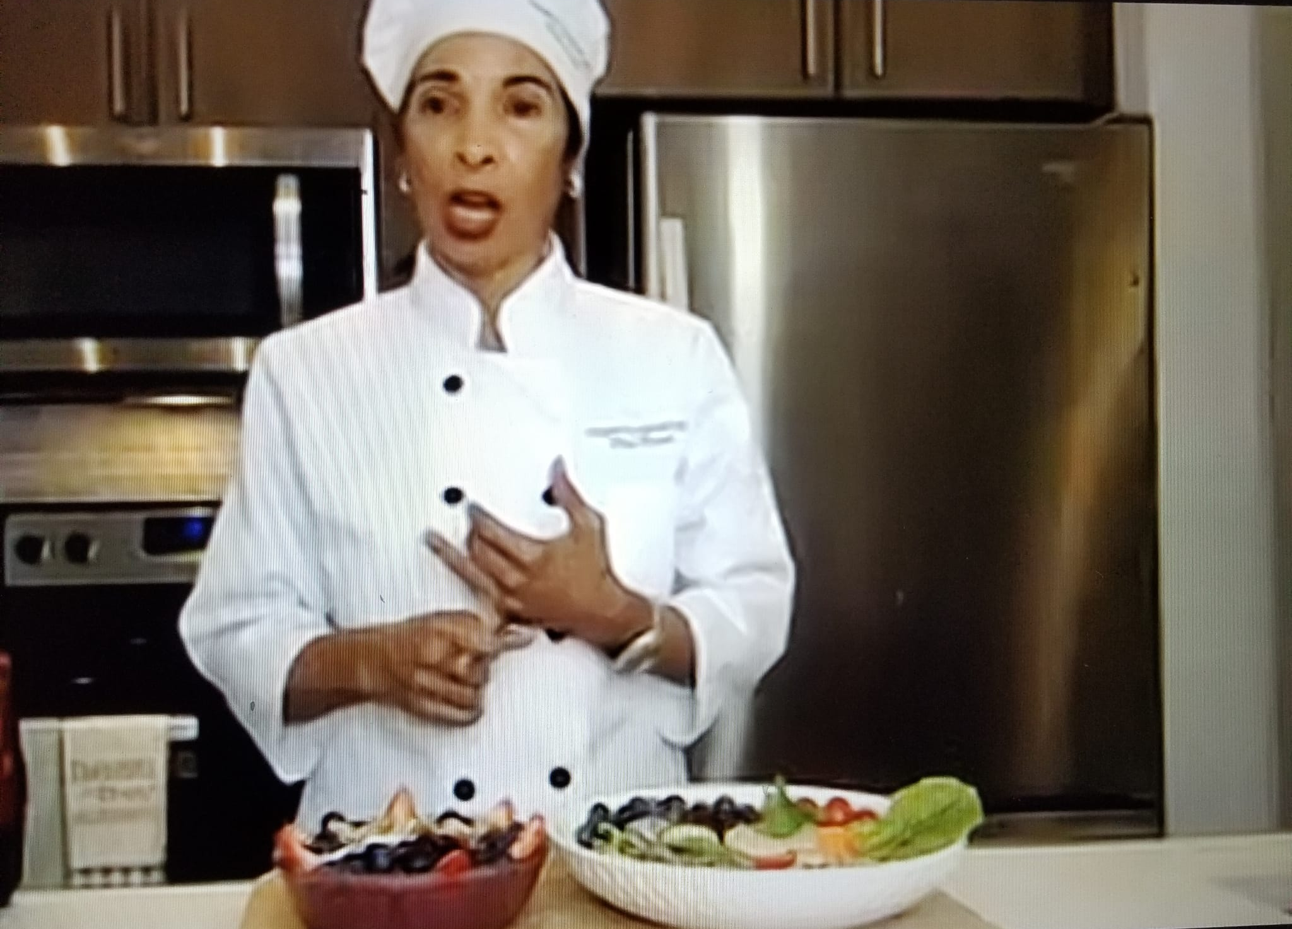

Slide 30
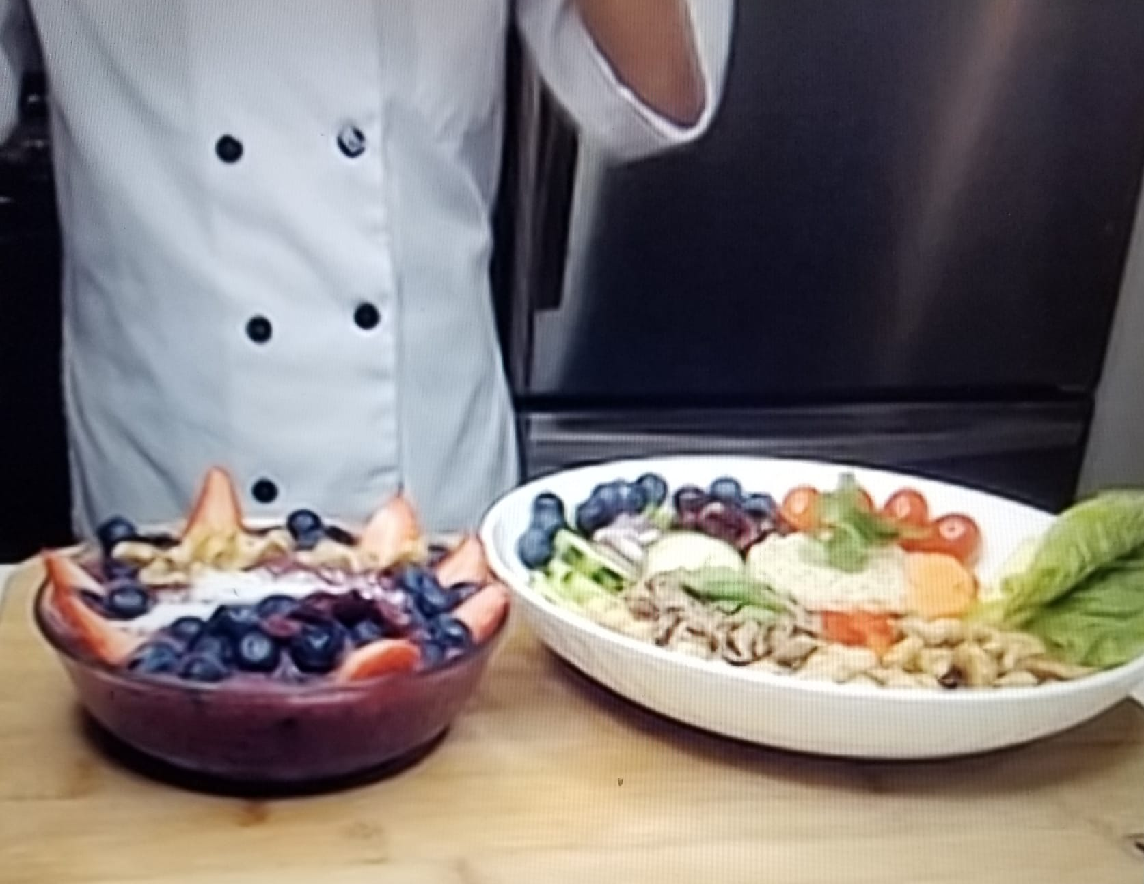

Slide 33
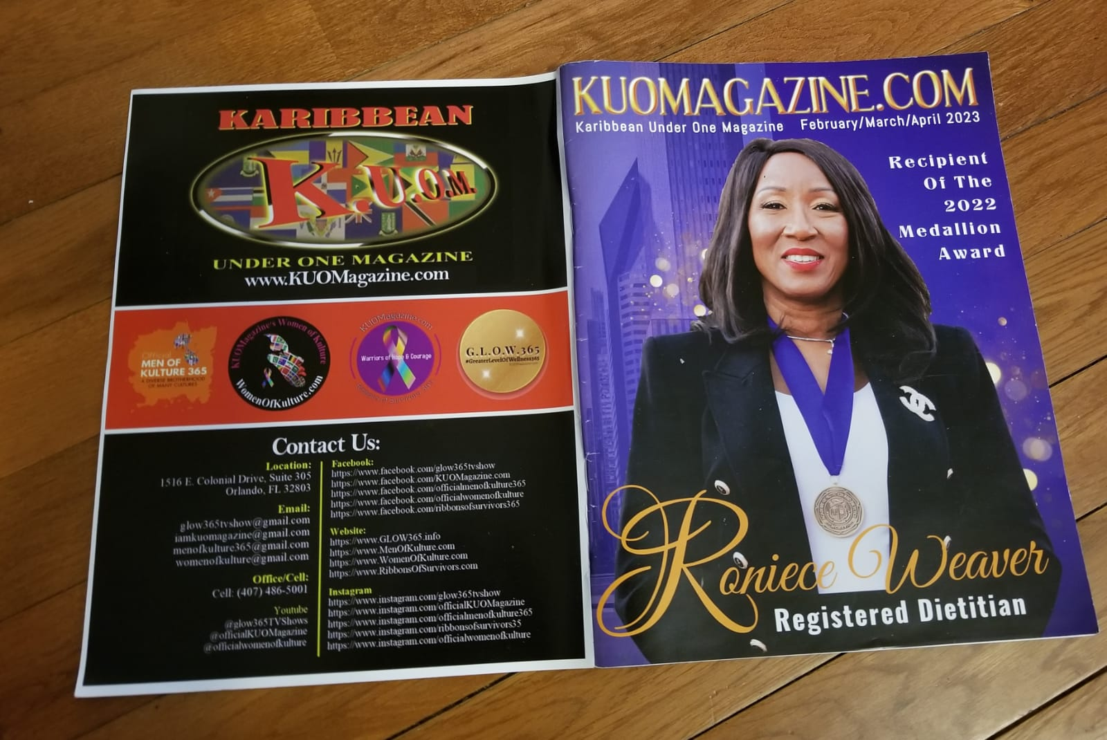
Health by Design USA Inc. advertisement in local magazine. (Front)

Slide 34
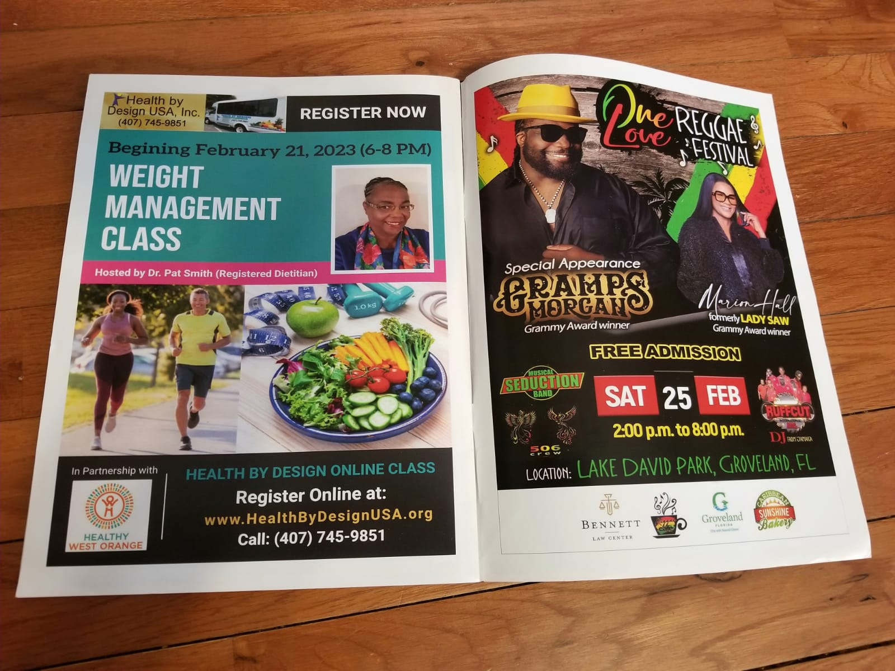
Health by Design USA Inc. advertisement in local magazine. (Back)

Slide 35
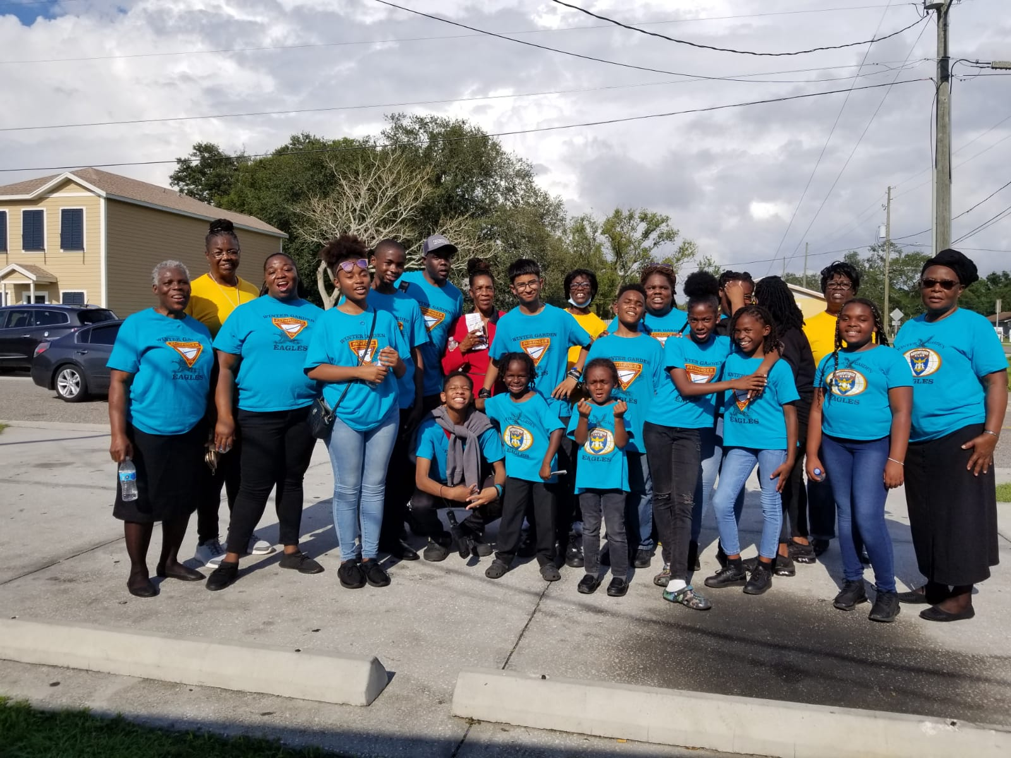
Thank You!
Thanks to all those who came out on Saturday afternoon to the Blood pressure screening in the East Winter Garden Community. Special thanks to Ms. Jennifer Binns, Ms. Myrtle Bower, Ms. Hazel Douglas and Mr. Trenton Jones as well as to all the young people from our community partner: Winter Garden SDA Church. The Winter Garden Eagles Pathfinders and Adventurers Clubs Members. Thanks for your support and commitment.

Slide 36
Thank You!

