Slide 1

TEACHING READING IN THE UPPER GRADES
CHRISTINE PERKIN
@LEARNINGWITHPERKS
2023
www.learningwithperks.com

Slide 2

Hello
PLease feel free to discuss, comment & ask questions throughout the session!

Slide 3
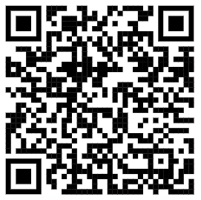
Resource SHARE & Links
Science of Reading
WWW.LEARNINGWITHPERKS.COM/CONFERENCE
2023
@LearningWithPerks

Slide 4
Reading is COMPLEX!
PURPOSE FOR TODAY’S SESSION
-What reading truly is
-How we learn to read
-The brain (we were not born ready to read)
-How to target the different components of reading
-How to teach foundational skills for older striving readers
-Resources and strategies for whole class reading instruction
-Resources and strategies for small group reading instruction
@LearningWithPerks

Slide 5
Setting the Context
QUESTIONS I OFTEN HEAR:
-Why are some of my students not able to read in Middle School?
-How do I help these students?
-I am not a reading teacher - that’s not part of my job...
-What does it mean to have a reading disability or dyslexia?
-Why can’t my students keep up with the rest of the class?
-What does reading intervention look like with older students?
@LearningWithPerks

Slide 6

Notes:
https://youtu.be/dXg2oY6fC8w

Slide 7
The human brain is wired for
listening and speech - not for the skills needed to connect sounds to code (letters) and make meaning from it.
Science of Reading
THE HUMAN BRAIN WAS NOT WIRED TO READ TEXT.
2023
@LearningWithPerks

Slide 8
What happens in the brain
There is no single place in the brain that is activated to read. Instead, it is a connection of different parts of our brain that is needed to be a strong reader. Our brains were not wired for reading like it is for spoken language. As children learn to read, their brain must evolve and build new neural pathways, changing the way it functions. For most students, regular classroom instruction and practice is enough to “train” the brain in this new way to become a sufficient reader. For some children, however, that part of the brain is not as strong. This means that they need MUCH more exposure to the foundational skills of reading for it to become automatic in their brains.

Slide 9
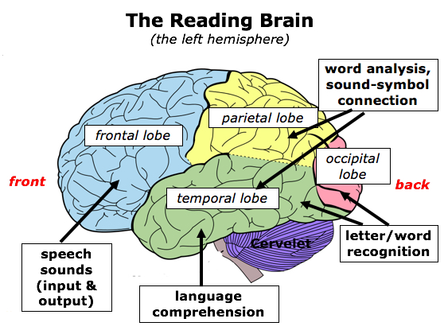

Slide 10
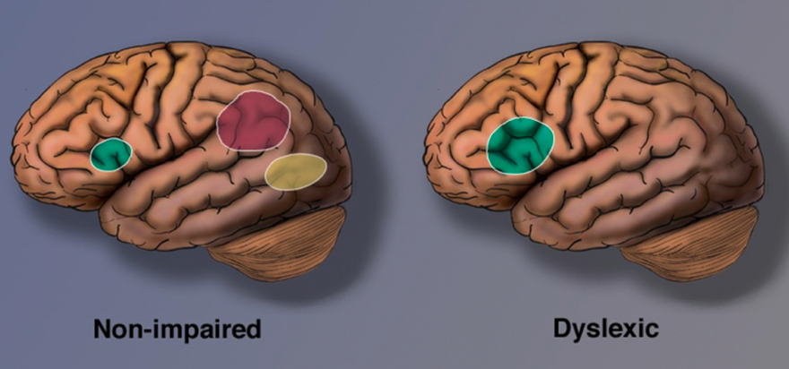
The Dyslexic Brain
Brain scans of struggling readers show activity that is quite different and much more scattered than the brain activity of strong readers.
Shaywitz et al. (2002)

Slide 11
Dyslexia
A common myth is that dyslexia is only related to letter reversals or reading words backwards. Although this can be a part of having dyslexia, it is a reading disability that is connected to DECODING WORDS and connecting the sounds they hear to the letters in the word.
Dyslexia is not related to intelligence at all. Most people with dyslexia have an average or above average IQ.
The dyslexic brain requires EXPLICIT and SYSTEMATIC teaching of phonemic awareness and decoding skills.
With strong intervention in these areas, the dyslexic brain CAN “re-wire” itself to be a strong reader. The older the student, the greater the length and intensity of the intruction. Early intervention is best!

Slide 12
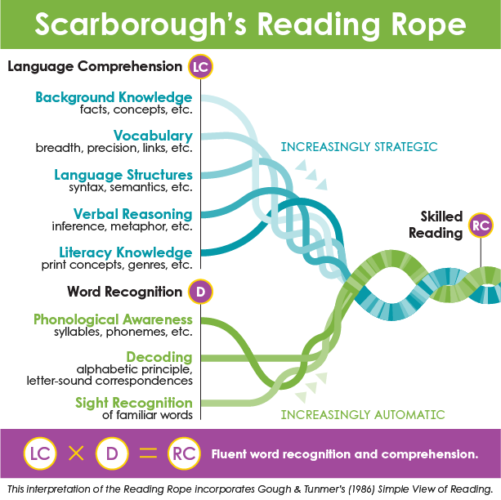
Science of Reading
2023
@LearningWithPerks

Slide 13
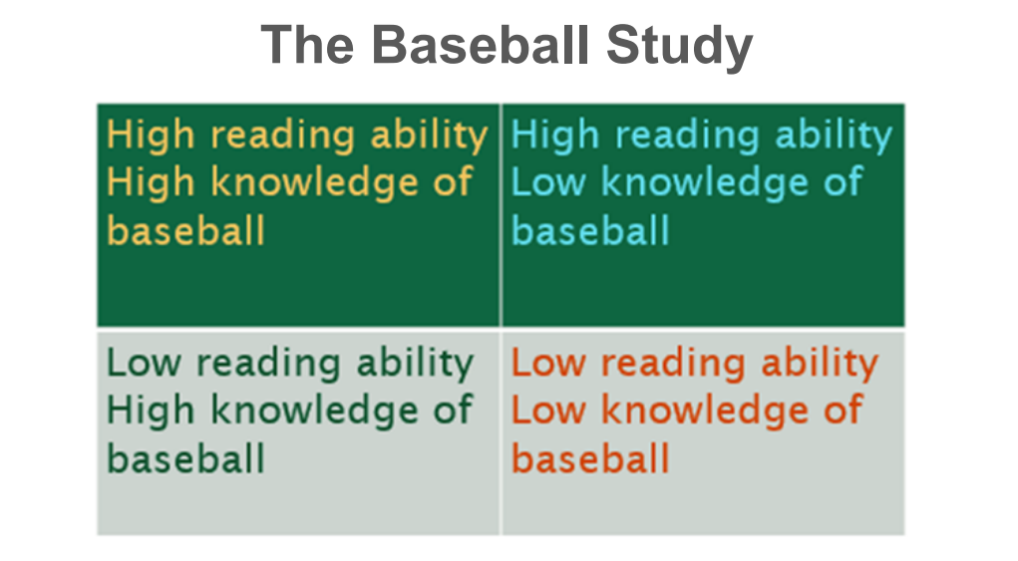
Background Knowledge

Slide 14
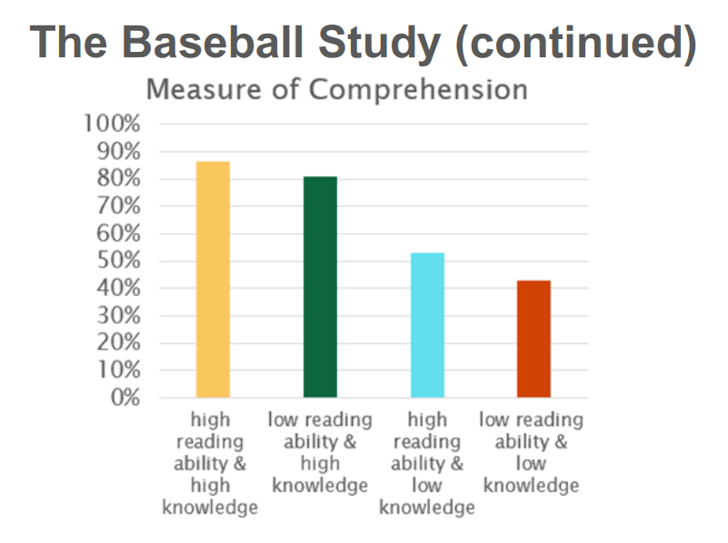

Slide 15
Vocabulary
Use rich Vocabulary and talk about language & word structures!
Focusing on vocabulary doesn't just mean looking up the word from a list and copying the definition. Although you may find this helpful for filling student notebooks with study material.... are they truly understanding the words?! Instead, make time in your lessons to talk about the words, their structure, and their connections to other topics. A great place to start is to bring in an awareness of ROOT WORDS, PREFIX and SUFFIX. Do some research prior to teaching the lesson to understand for yourself where these vocabulary words come from and how they are connected to concepts.

Slide 16

Vocabulary
IDEA for VOCAB exposure: Word Study
Word of the Day
{bonus: connect this to your content areas!}
Choose a long word to study each day/week
METEOROLOGIST (for example)
-How can I break it down? (syllables, sounds, prefix/suffix?)
-What is living inside of it? (smaller words? letter patterns? Morphemes? Etymology?)
-Who is in the gang? (ie: other words that end in -ologist? Other words connected to meaning?
-Connect to subject
-Use in context with intention throughout discussions & lesson

Slide 17
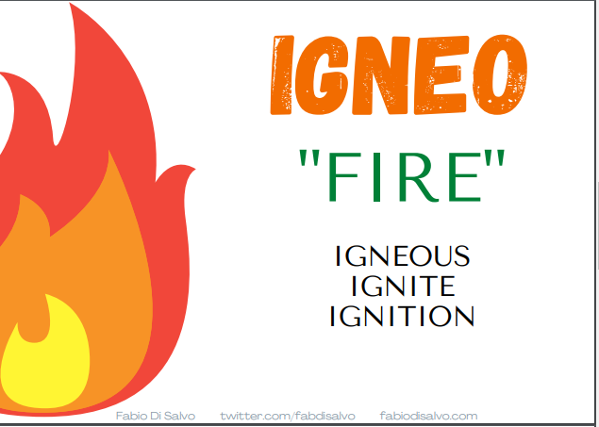
https://www.etymonline.com/
{Enter any word and find the original root and meaning behind the word!}
{BEAUTIFUL freebie by Fabio Di Salvo - Root Word Posters for the Classroom!}

Slide 18
Science of Reading
2023
@LearningWithPerks

Slide 19


Phonological Awareness
&
Decoding
Targeted, Small Group
Structured Literacy

Slide 20
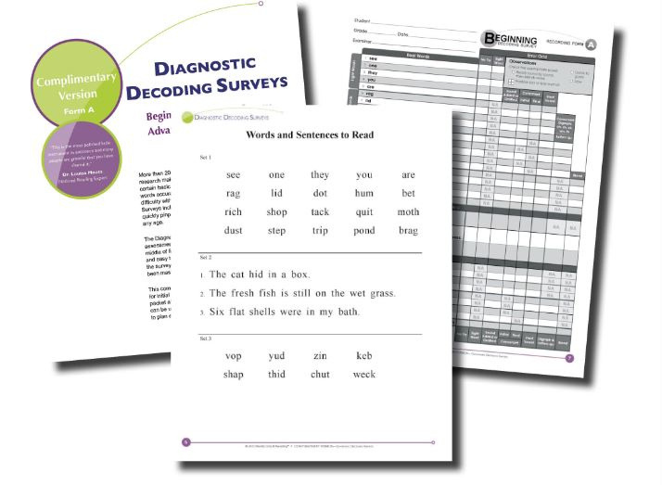

Assessment: Decoding Surveys

Slide 21
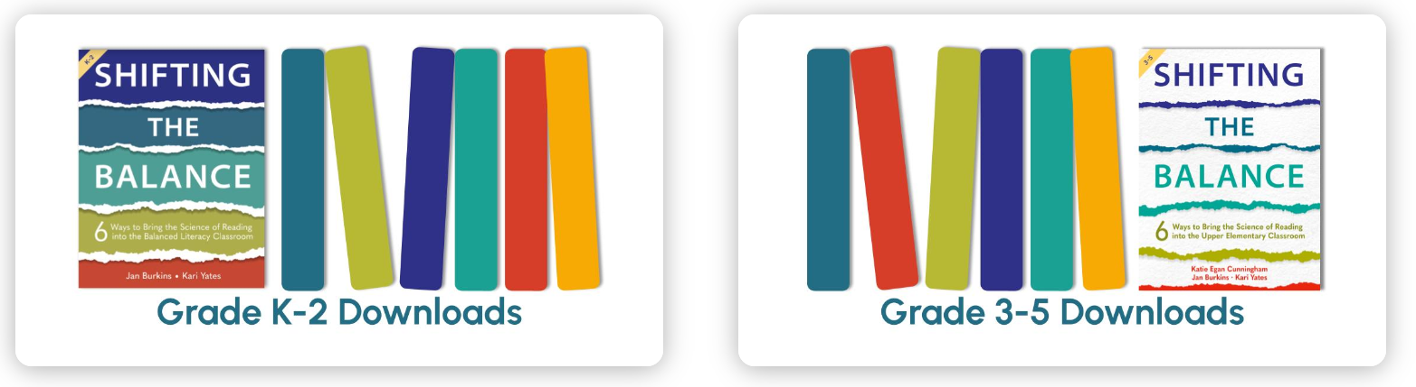
Phonemic Awareness

Slide 22
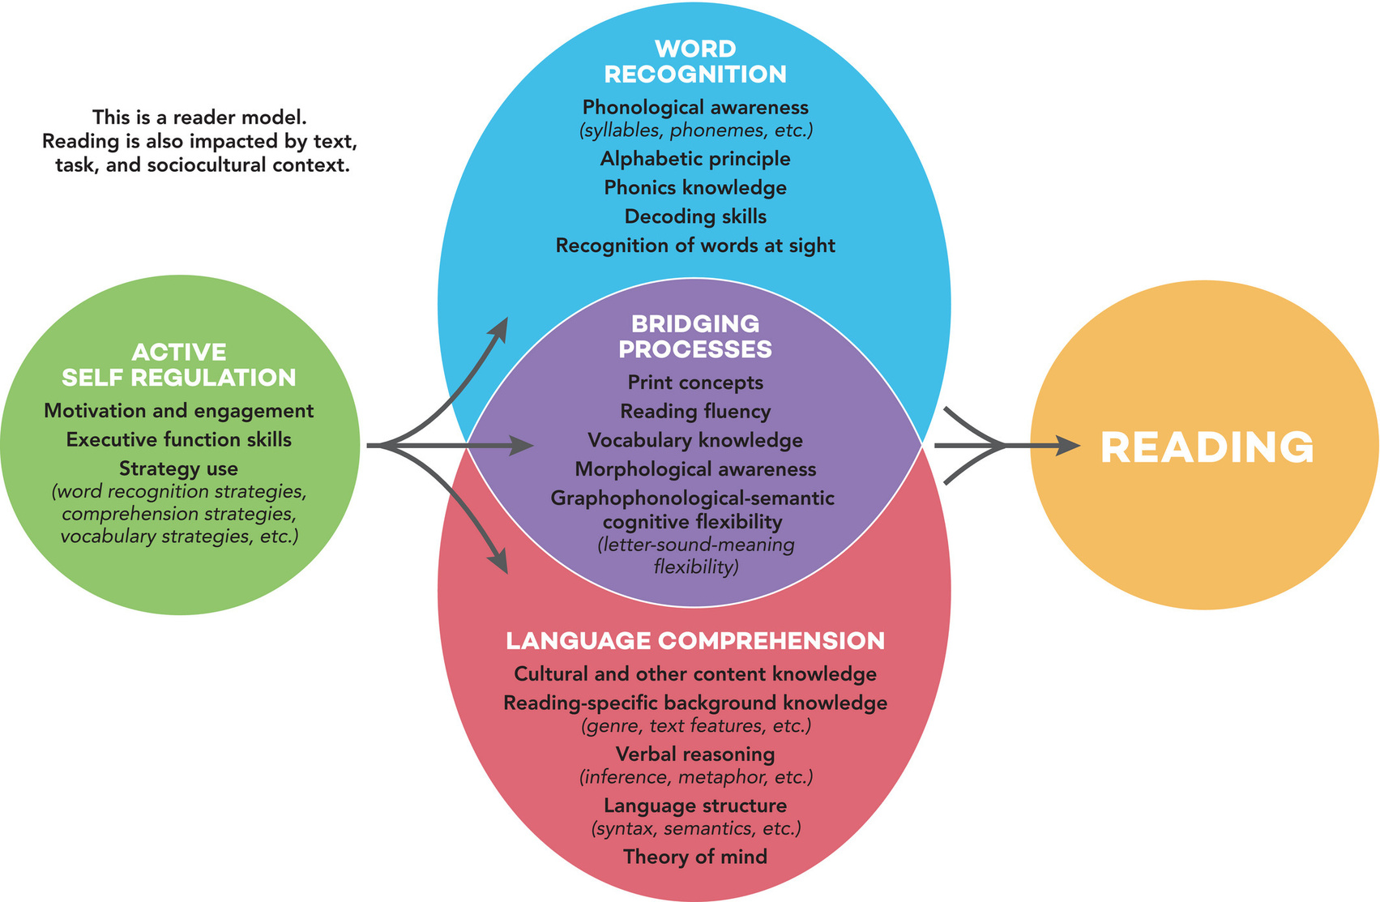
THE ACTIVE VIEW OF READING

Slide 23
When teaching older readers:
go as fast as you can, but as slow as you need to
Science of Reading
2023
@LearningWithPerks

Slide 24
HOW TO MAKE IT “NOT-BABYISH”
TEACH them about how the brain works and how we learn to read
Use vocabulary and terms that you may not use with younger kids
Find text that is high interest but decodable at a level that is good for them
NORMALIZE ACCOMMODATIONS IN THE CLASS!

Slide 25
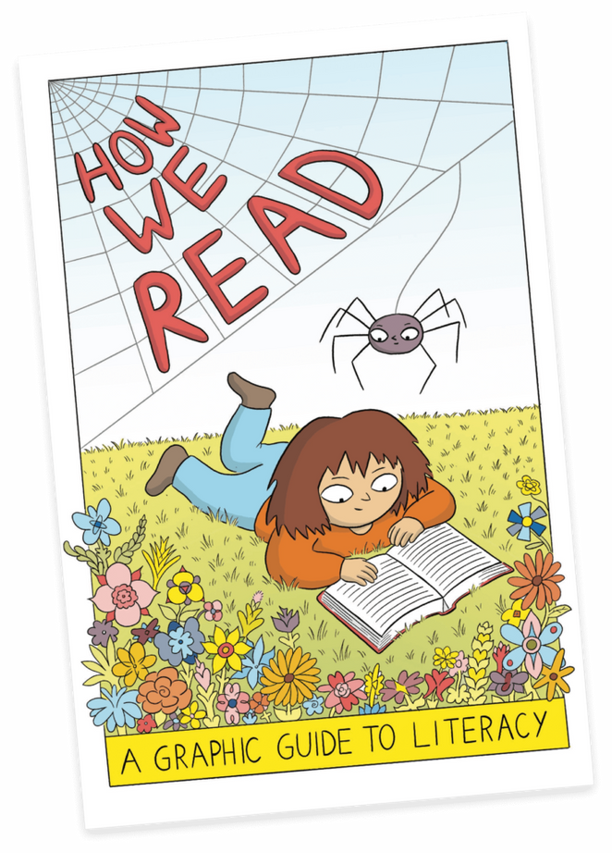
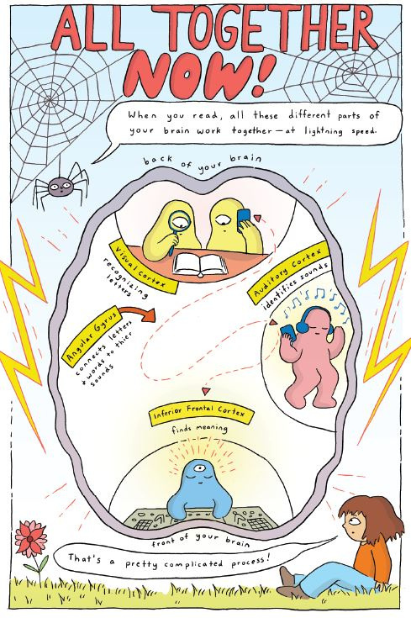
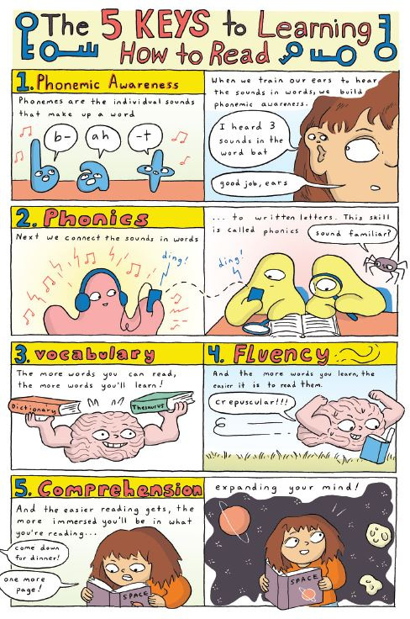
HOW WE READ - A GRAPHIC NOVEL
@LearningWithPerks
Reading is Complex
https://www.cartoonstudies.org/css-studio/cartooningprojects/reading/

Slide 26
Phonics
Connecting the sounds to we hear in words to letters and letter groups
-word chains
-counting sounds or syllables in vocabulary words
-mapping words - one sound per box

Slide 27
Reading Fluency:
98+% = strong decoding
92%-97% = Grade Level Decoding
Under 92% = Below Grade Level Decoding
When students are not decoding at 92% accuracy or higher, the working memory is being almost completely used up for decoding, leaving no working memory left for the comprehension part of reading
2023
@LearningWithPerks

Slide 28
How do I find out the reading accuracy rate?
-Grade level Passage
-1 minute timer
-count # of words read
-subtract # of errors to find correct words read
Accuracy = words correct/total words read

Slide 29
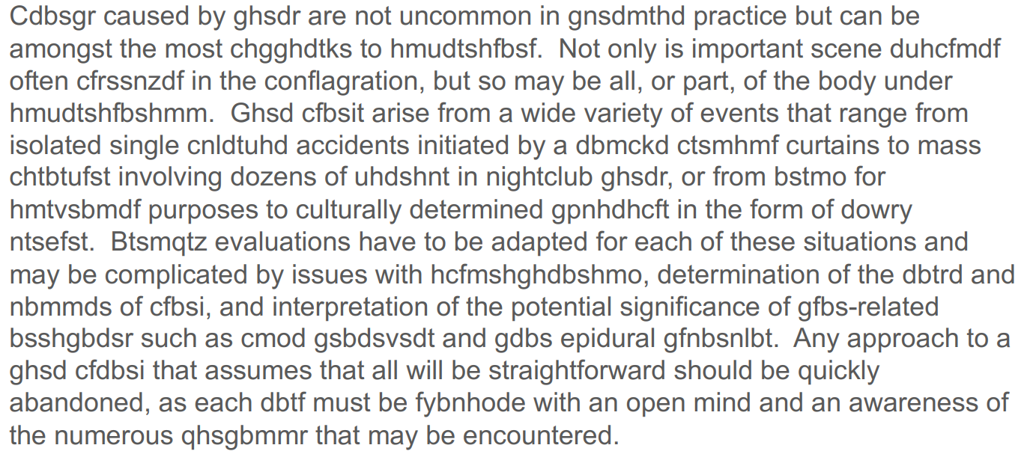
Reading with 80% fluency

Slide 30
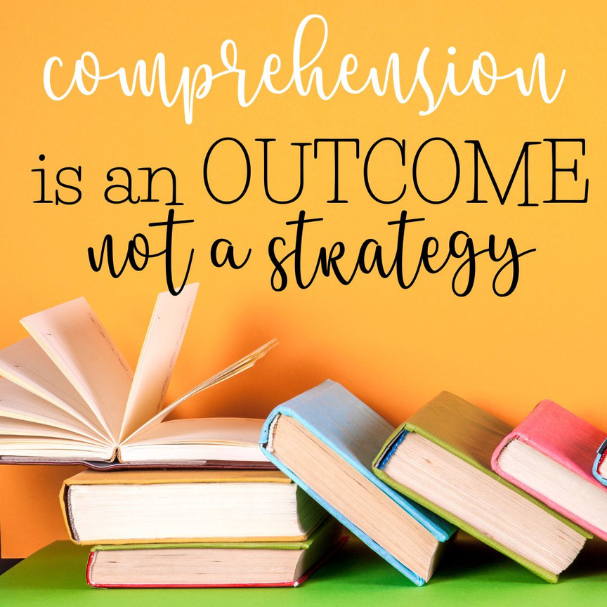
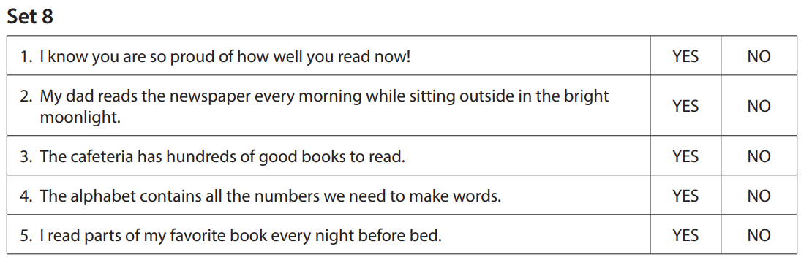
Comprehension
DIMS -does it make sense?
Reading Powers
by Adrienne Gear

Slide 31
SO - WHAT NOW??
  There are some things that you can do in the whole class setting to help our striving readers
  Small group work is also very important, if possible
www.learningwithperks.com

Slide 32
STRUCTURED READING
  What is structured literacy?
  How does this apply to older readers?
  filling in the gaps
  assessment
  scope & sequence
www.learningwithperks.com
01
/ 12

Slide 33
ACCOMODATE FOR GRADE LEVEL EXPOSURE
-Read & Write Google Extension
-Assistive technology use when possible
-Headphones available
-TALK ABOUT IT WITH THE WHOLE CLASS!
www.learningwithperks.com

Slide 34

Fair VS Equal
The Glasses Story
We all learn differently, and everyone gets what they need to be most successful

Slide 35
SMALL GROUPS IN THE MIDDLE SCHOOL CLASS
-technology station
-Non-technology station
(Reading Powers)
-Small group work - targeted teacher time

Slide 36


TECHNOLOGY RESOURCES

Slide 37
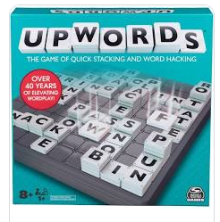

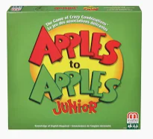
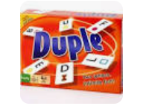




WORD GAMES

Slide 38
Final Takeaways:
  Continue to give grade level exposure, with accommodations
  Background Knowledge, Vocabulary, Language Understanding play a huge role in reading comprehension - all subject areas can teach and enhance this area of literacy instruction
  Reading is COMPLEX! BUt, striving readers CAN learn to read with explicit, strategic literacy instruction
  Normalize learning differences in your classroom, along with accommodations for all that need them.
GIVE YOURSELF GRACE!
Pick one thing that feels manageable, and just start!
@LearningWithPerks

Slide 39

THANK YOU!
Christine Perkin
clperkin@cbe.ab.ca
@LearningWithPerks
Resources
Links
More Info
www.learningwithperks.com/conference
Thank You

